Slide 1
Week11a
WARMUP
What does this print?
PRINT(0.1 + 0.2);
PRINT(SQRT(2.0) * SQRT(2.0));
the Fibonacci sequence
recursion
dynamic programming
🦜🦜🦜🦜🦜🦜🦜🦜🦜🦜🦜
🍉
WARMUP
What is F₇?
F₀ = 0
F₁ = 1
F_{k} = F_{k - 1} + F_{k - 2}

Slide 2
what are these?
🍉

Slide 3

the

Slide 4
👼

Slide 5
the Fibonacci sequence

Slide 6


Slide 7
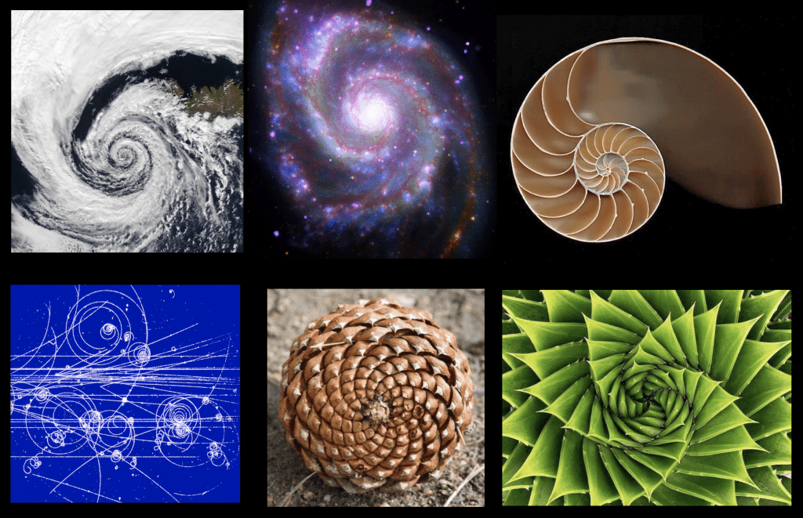

Slide 8
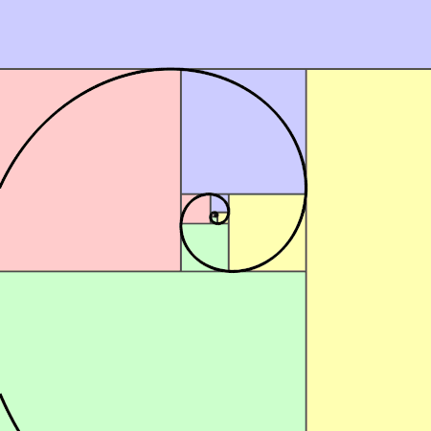

Slide 9
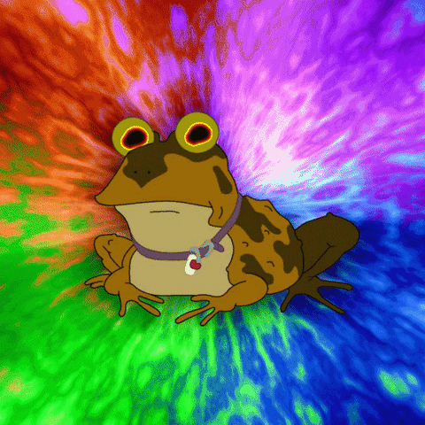

Slide 10
// F_0 = 0
// F_1 = 1
// F_2 = F_1 + F_0 = 1 + 0 = 1
// F_3 = F_2 + F_1 = 1 + 1 = 2
// F_4 = F_3 + F_2 = 2 + 1 = 3
// F_5 = F_4 + F_3 = 3 + 2 = 5
// F_6 = F_5 + F_4 = 5 + 3 = 8
// F_7 = F_6 + F_5 = 8 + 5 = 13
// ...

Slide 11
recursion

Slide 12
review: recursion basics

Slide 13
recursion
a recursive function is a function that calls itself
each call must make progress towards a base case (when the function finally returns without calling itself)
✨ when in doubt, try something like zero for your base case
class Main {
static int digitSum(int n) {
if (n == 0) {
return 0;
}
return digitSum(n / 10) + (n % 10);
}
public static void main(String[] arguments) {
PRINT(digitSum(256)); // 13
}
}

Slide 14
static int digitSum(int n) {
if (n == 0) {
return 0;
}
return digitSum(n / 10) + (n % 10);
}
return 0;
return digitSum(0) + 2;
return digitSum(2) + 5;
return digitSum(25) + 6;
int a = digitSum(256);

Slide 15
static int digitSum(int n) {
if (n == 0) {
return 0;
}
return digitSum(n / 10) + (n % 10);
}
return 0;
return digitSum(0) + 2;
return digitSum(2) + 5;
return digitSum(25) + 6;
int a = digitSum(256);

Slide 16
static int digitSum(int n) {
if (n == 0) {
return 0;
}
return digitSum(n / 10) + (n % 10);
}
return 0 + 2;
return digitSum(2) + 5;
return digitSum(25) + 6;
int a = digitSum(256);

Slide 17
static int digitSum(int n) {
if (n == 0) {
return 0;
}
return digitSum(n / 10) + (n % 10);
}
return 2;
return digitSum(2) + 5;
return digitSum(25) + 6;
int a = digitSum(256);

Slide 18
static int digitSum(int n) {
if (n == 0) {
return 0;
}
return digitSum(n / 10) + (n % 10);
}
return 2;
return digitSum(2) + 5;
return digitSum(25) + 6;
int a = digitSum(256);

Slide 19
static int digitSum(int n) {
if (n == 0) {
return 0;
}
return digitSum(n / 10) + (n % 10);
}
return 2 + 5;
return digitSum(25) + 6;
int a = digitSum(256);

Slide 20
static int digitSum(int n) {
if (n == 0) {
return 0;
}
return digitSum(n / 10) + (n % 10);
}
return 7;
return digitSum(25) + 6;
int a = digitSum(256);

Slide 21
static int digitSum(int n) {
if (n == 0) {
return 0;
}
return digitSum(n / 10) + (n % 10);
}
return 7;
return digitSum(25) + 6;
int a = digitSum(256);

Slide 22
static int digitSum(int n) {
if (n == 0) {
return 0;
}
return digitSum(n / 10) + (n % 10);
}
return 7 + 6;
int a = digitSum(256);

Slide 23
static int digitSum(int n) {
if (n == 0) {
return 0;
}
return digitSum(n / 10) + (n % 10);
}
return 13;
int a = digitSum(256);

Slide 24
static int digitSum(int n) {
if (n == 0) {
return 0;
}
return digitSum(n / 10) + (n % 10);
}
return 13;
int a = digitSum(256);

Slide 25
static int digitSum(int n) {
if (n == 0) {
return 0;
}
return digitSum(n / 10) + (n % 10);
}
int a = 13;

Slide 26
fin.

Slide 27
⚠️ recursion hazard 1 repeated computation

Slide 28
🐌 example: slow very slow fibonnaci (couldn't we just use a for loop...?)
// F_0 = 0
// F_1 = 1
// F_2 = F_1 + F_0 = 1 + 0 = 1
// F_3 = F_2 + F_1 = 1 + 1 = 2
// F_4 = F_3 + F_2 = 2 + 1 = 3
// F_5 = F_4 + F_3 = 3 + 2 = 5
// ...
static long fib(long k) {
if (k == 0) { return 0; }
if (k == 1) { return 1; }
return fib(k - 1) + fib(k - 2);
}

Slide 29
fib(4)

Slide 30
(fib(3) + fib(2))

Slide 31
((fib(2) + fib(1)) + (fib(1) + fib(0)))

Slide 32
(((fib(1) + fib(0)) + fib(1)) + (fib(1) + fib(0)))

Slide 33
(((1 + 0) + 1) + (1 + 0))

Slide 34
((1 + 1) + 1)

Slide 35
(2 + 1)

Slide 36
3

Slide 37
fib(4)

Slide 38
fib(4)
fib(3)
fib(2)

Slide 39
fib(4)
fib(3)
fib(2)
fib(2)
fib(1)

Slide 40
fib(4)
fib(3)
fib(2)
fib(2)
fib(1)
fib(1)
fib(0)

Slide 41
fib(4)
fib(3)
fib(2)
fib(2)
fib(1)
1
0

Slide 42
fib(4)
fib(3)
fib(2)
1
fib(1)

Slide 43
fib(4)
fib(3)
fib(2)
1
1

Slide 44
fib(4)
2
fib(2)

Slide 45
fib(4)
2
fib(2)
fib(1)
fib(0)

Slide 46
fib(4)
2
fib(2)
1
0

Slide 47
fib(4)
2
1

Slide 48
3

Slide 49
🙂

Slide 50
☹️

Slide 51
3

Slide 52
fib(4)

Slide 53
fib(4)
fib(3)
fib(2)
fib(2)
fib(1)
fib(1)
fib(0)
😱 what about this picture does NOT spark joy?
fib(1)
fib(0)

Slide 54
fib(4)
fib(3)
fib(2)
fib(2)
fib(1)
fib(1)
fib(0)
fib(1)
fib(0)

Slide 55
we computed fib(2) from scratch two seperate times 😱 we are repeating computation! (what a waste 😞)

Slide 56
and for bigger n... there is (much) more repetition

Slide 57
F₆
F₄
F₅
F₂
F₃
F₃
F₄
F₀
F₁
F₁
F₂
F₁
F₂
F₂
F₃
F₀
F₁
F₀
F₁
F₀
F₁
F₁
F₂
F₀
F₁

Slide 58

F₆
F₄
F₅
F₂
F₃
F₃
F₄
F₀
F₁
F₁
F₂
F₁
F₂
F₂
F₃
F₀
F₁
F₀
F₁
F₀
F₁
F₁
F₂
F₀
F₁
🧠 who's that
big O runtime?

Slide 59
exponential 🙀

Slide 60
[fib(5), fib(36), fib(77) demo]

Slide 61
⚠️ recursion hazard 2 stack overflow

Slide 62
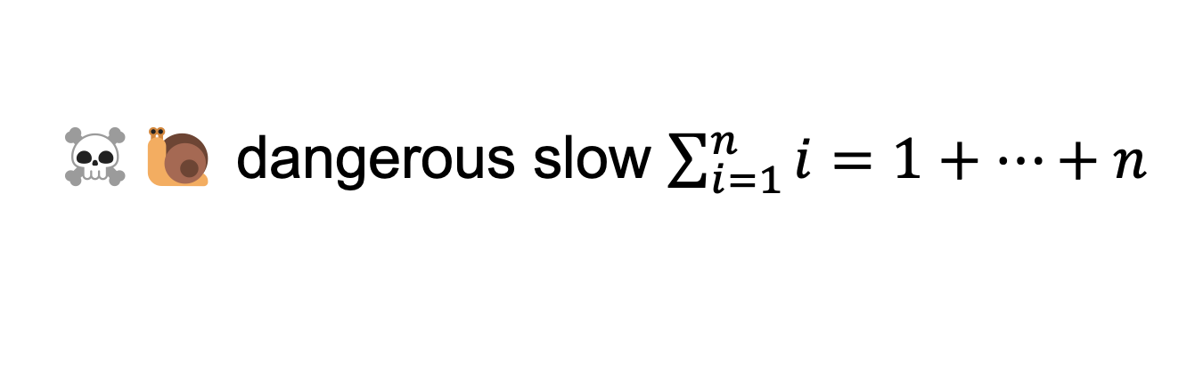
☠️🐌 dangerous slow $\sum_{i=1}^{n}{i}=1+…+n$
// 1 + ... + n
static int sum(int n) {
if (n == 0) return 0;
return n + sum(n - 1);
}

Slide 63
sum(100000)

Slide 64
sum(99999)
sum(100000)

Slide 65
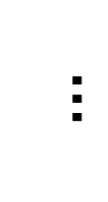
sum(0)
$$…$$
😱 what about this picture does NOT spark joy?
sum(99999)
sum(100000)

Slide 66
the height of the callstack is O(n) 😱 big n → stack overflow! 😞

Slide 67
[sum(100000) demo]

Slide 68
🧠 our depth-first binary (search) tree traversals were recursive... ...should we be worried about them overflowing the callstack?

Slide 69
no. (assuming your tree is ~balanced) callstack height for depth-first balanced binary tree traversal is log(n)
0
1
2
3
4 5
1 1 1 1 1 2 3
0 0 0 0 0 0 0 0 0 0 0
4
5
time

Slide 70
*additionally, some languages/compilers** have "tail-call optimization," which would prevent a stack overflow for sum(100000) **Java is not one of these languages (as our demo showed)

Slide 71
dynamic programming

Slide 72
dynamic programming is when you use the result of previous computation (this is a squishy definition)

Slide 73
F₆
F₄
F₅
F₂
F₃
F₃
F₄
F₀
F₁
F₁
F₂
F₁
F₂
F₂
F₃
F₀
F₁
F₀
F₁
F₀
F₁
F₁
F₂
F₀
F₁

Slide 74
F₆
F₅
F₄
F₄
F₃
F₃
F₂
F₂
F₁
F₁
F₀

Slide 75
F₆
F₅
F₄
F₄
F₃
F₃
F₂
F₂
F₁
F₁
F₀
🧠 who's that
big O runtime?

Slide 76
linear 🙂👍

Slide 77
memoization

Slide 78
memoization means storing the results of previous functions calls, so we don't have to repeat work when the function is called again

Slide 79
🙂 memoized fibonacci
static HashMap<Long, Long> table = new HashMap<>();
static long memoizedFib(long k) { // NOTE: long is an integer type
// that can store larger numbers than int
if (k == 0) { return 0; }
if (k == 1) { return 1; }
long Fkm1;
if (table.containsKey(k - 1)) {
Fkm1 = table.get(k - 1);
} else {
Fkm1 = memoizedFib(k - 1);
table.put(k - 1, Fkm1);
}
long Fkm2;
if (table.containsKey(k - 2)) {
Fkm2 = table.get(k - 2);
} else {
Fkm2 = memoizedFib(k - 2);
table.put(k - 2, Fkm2);
}
return Fkm1 + Fkm2;
}
🧠 what's the runtime of each call to memoizedFib(...)?
public static void main(...) {
int n = ...;
long a = memoizedFib(n);
long b = memoizedFib(n - 1);
long c = memoizedFib(n + 1);
}

Slide 80
int n = ...; long a = memoizedFib(n); // O(n) long b = memoizedFib(n - 1); // O(1) long c = memoizedFib(n + 1); // O(1)

Slide 81
👻 closed form fibonacci

Slide 82
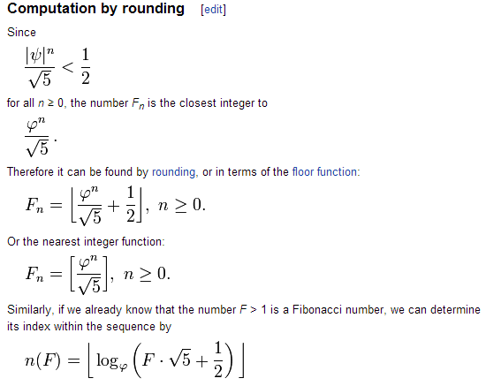

Slide 83
👻 approximate closed-form fibonnaci
// NOTE: Because of floating point error, this does not work for big n.
// (On my computer, returns wrong result for n > 70.)
static long closedFormFib(long n) {
final double goldenRatio = (1.0 + Math.sqrt(5.0)) / 2.0;
return Math.round(Math.pow(goldenRatio, n) / Math.sqrt(5.0));
}

Slide 84
exponentiation by squaring

Slide 85
note: there is actually a log(n) algorithm using matrices and "exponentiation by squaring" this algorithm does NOT have floating point problems (all numbers are integers)

Slide 86
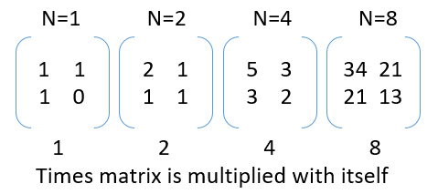

Slide 87
Week11b
WARMUP
Say n = 64
Your goal is to compute 3^n ("3 to the n-th power") using only the multiplication operator (*)
Give an O(n) algorithm
Give an O(log n) algorithm
Fibonacci wrapup
recursion example
🦜🦜🦜🦜🦜🦜🦜🦜🦜🦜🦜

Slide 88
recursive fibonacci wrapup

Slide 89
review: bad bad very bad recursive O(2^n) fibonacci

Slide 90
🐌 recursive O(2^n) fibonacci
static long fib(long k) {
if (k == 0) { return 0; }
if (k == 1) { return 1; }
return fib(k - 1) + fib(k - 2);
}

Slide 91
review: recursive memoized O(n) fibonacci

Slide 92
🙂 memoized recursive O(n) fibonacci
// NOTE: Could also have used an array, with, for example, value 0 meaning "not yet computed."
static HashMap<Integer, Long> table = new HashMap<>();
static long fib(int k) {
if (k == 0) { return 0; }
if (k == 1) { return 1; }
long Fkm1;
if (table.containsKey(k - 1)) {
Fkm1 = table.get(k - 1);
} else {
Fkm1 = fib(k - 1);
table.put(k - 1, Fkm1);
}
long Fkm2;
if (table.containsKey(k - 2)) {
Fkm2 = table.get(k - 2);
} else {
Fkm2 = fib(k - 2);
table.put(k - 2, Fkm2);
}
return Fkm1 + Fkm2;
}

Slide 93
can we get the best of both worlds? (easy to read, fast)

Slide 94
[add a helper function]

Slide 95
🙂 recursive O(n) fibonnaci
static HashMap<Integer, Long> table = new HashMap<>();
static long fibHelper(int k) {
long result;
if (table.containsKey(k)) {
result = table.get(k);
} else {
result = fib(k);
table.put(k, result);
}
return result;
}
static long fib(int k) {
if (k == 0) { return 0; }
if (k == 1) { return 1; }
return fibHelper(k - 1) + fibHelper(k - 2);
}

Slide 96
alternate fibonacci approaches

Slide 97
iterative (not-recursive) O(n) fibonacci

Slide 98
🙂 iterative O(n) fibonnaci
(F₁, F₀) ← = (1, 0)
(F₂, F₁) ← (1 + 0, 1) = (1, 1)
(F₃, F₂) ← (1 + 1, 1) = (2, 1)
(F₄, F₃) ← (2 + 1, 2) = (3, 2)
(F₅, F₄) ← (3 + 2, 3) = (5, 3)
static long fib(int n) {
long F_i = 1;
long F_im1 = 0;
for (int i = 2; i <= n + 1; ++i) {
// (F_i, F_im1) <- (F_i + F_im1, F_i)
long tmp = F_i;
F_i += F_im1;
F_im1 = tmp;
}
return F_im1;
}
TODO make better
def fib(n):
F_i = 1
F_im1 = 0
for i in range(2, n + 2):
F_i, F_im1 = (F_i + F_im1), F_i
return F_im1

Slide 99
closed form fibonacci

Slide 101
👻 approximate closed-form fibonnaci
// NOTE: Because of floating point error, this does not work for big n.
// (On my computer, returns wrong result for n > 70.)
static long closedFormFib(long n) {
final double goldenRatio = (1.0 + Math.sqrt(5.0)) / 2.0;
return Math.round(Math.pow(goldenRatio, n) / Math.sqrt(5.0));
}

Slide 102
O(log n) matrix exponentiation by squaring (oh no) 😀

Slide 103
problem: calculate fib(64) observation: 64 = 2 * 2 * 2 * 2 * 2 * 2

Slide 104
[matrix multiplication review]

Slide 105
[update rule as a matrix multiplication]

Slide 106
[matrix exponentiation by squaring]

Slide 107
recursion example subset sum

Slide 108
problem overview

Slide 109
given a finite set of numbers $\{a,b,c,…\}$, is there any subset that sums to target $T$?

Slide 110
no. --Mark

Slide 111
examples
is there any subset of { 1, 3, 5 } that sums to 4?
yes; { 1, 3 }
is there any subset of { 1, 3, 5 } that sums to 9?
yes; { 1, 3, 5 }
is there any subset of { 1, 3, 5 } that sums to 0?
yes; {}
is there any subset of { 1, 3, 5 } that sums to 7?
no

Slide 112
solution method

Slide 113
given a finite set of numbers $\{a,b,c,…\}$, is there any subset that sums to target $T$?

Slide 114
given a finite set of numbers $\{a,b,c,…\}$, is there any subset that sums to target $T$?

Slide 115
any
for each subset...
if it sums to target...
return true; 🙂
return false;

Slide 116
🧠 why is this maybe not so easy? "hard" means "hard for a computer to solve quickly"
for each subset...
if it sums to target...
return true; 🙂
return false;

Slide 117
what are the subsets of $\{ 1, 2, 3, 4, 5, 6, 7, 8, 9 \}$?

Slide 118
∅ | {1} | {2} | {3} | {4} | {5} | {6} | {7} | {8} | {9} | {1, 2} | {1, 3} | {1, 4} | {1, 5} | {1, 6} | {1, 7} | {1, 8} | {1, 9} | {2, 3} | {2, 4} | {2, 5} | {2, 6} | {2, 7} | {2, 8} | {2, 9} | {3, 4} | {3, 5} | {3, 6} | {3, 7} | {3, 8} | {3, 9} | {4, 5} | {4, 6} | {4, 7} | {4, 8} | {4, 9} | {5, 6} | {5, 7} | {5, 8} | {5, 9} | {6, 7} | {6, 8} | {6, 9} | {7, 8} | {7, 9} | {8, 9} | {1, 2, 3} | {1, 2, 4} | {1, 2, 5} | {1, 2, 6} | {1, 2, 7} | {1, 2, 8} | {1, 2, 9} | {1, 3, 4} | {1, 3, 5} | {1, 3, 6} | {1, 3, 7} | {1, 3, 8} | {1, 3, 9} | {1, 4, 5} | {1, 4, 6} | {1, 4, 7} | {1, 4, 8} | {1, 4, 9} | {1, 5, 6} | {1, 5, 7} | {1, 5, 8} | {1, 5, 9} | {1, 6, 7} | {1, 6, 8} | {1, 6, 9} | {1, 7, 8} | {1, 7, 9} | {1, 8, 9} | {2, 3, 4} | {2, 3, 5} | {2, 3, 6} | {2, 3, 7} | {2, 3, 8} | {2, 3, 9} | {2, 4, 5} | {2, 4, 6} | {2, 4, 7} | {2, 4, 8} | {2, 4, 9} | {2, 5, 6} | {2, 5, 7} | {2, 5, 8} | {2, 5, 9} | {2, 6, 7} | {2, 6, 8} | {2, 6, 9} | {2, 7, 8} | {2, 7, 9} | {2, 8, 9} | {3, 4, 5} | {3, 4, 6} | {3, 4, 7} | {3, 4, 8} | {3, 4, 9} | {3, 5, 6} | {3, 5, 7} | {3, 5, 8} | {3, 5, 9} | {3, 6, 7} | {3, 6, 8} | {3, 6, 9} | {3, 7, 8} | {3, 7, 9} | {3, 8, 9} | {4, 5, 6} | {4, 5, 7} | {4, 5, 8} | {4, 5, 9} | {4, 6, 7} | {4, 6, 8} | {4, 6, 9} | {4, 7, 8} | {4, 7, 9} | {4, 8, 9} | {5, 6, 7} | {5, 6, 8} | {5, 6, 9} | {5, 7, 8} | {5, 7, 9} | {5, 8, 9} | {6, 7, 8} | {6, 7, 9} | {6, 8, 9} | {7, 8, 9} | {1, 2, 3, 4} | {1, 2, 3, 5} | {1, 2, 3, 6} | {1, 2, 3, 7} | {1, 2, 3, 8} | {1, 2, 3, 9} | {1, 2, 4, 5} | {1, 2, 4, 6} | {1, 2, 4, 7} | {1, 2, 4, 8} | {1, 2, 4, 9} | {1, 2, 5, 6} | {1, 2, 5, 7} | {1, 2, 5, 8} | {1, 2, 5, 9} | {1, 2, 6, 7} | {1, 2, 6, 8} | {1, 2, 6, 9} | {1, 2, 7, 8} | {1, 2, 7, 9} | {1, 2, 8, 9} | {1, 3, 4, 5} | {1, 3, 4, 6} | {1, 3, 4, 7} | {1, 3, 4, 8} | {1, 3, 4, 9} | {1, 3, 5, 6} | {1, 3, 5, 7} | {1, 3, 5, 8} | {1, 3, 5, 9} | {1, 3, 6, 7} | {1, 3, 6, 8} | {1, 3, 6, 9} | {1, 3, 7, 8} | {1, 3, 7, 9} | {1, 3, 8, 9} | {1, 4, 5, 6} | {1, 4, 5, 7} | {1, 4, 5, 8} | {1, 4, 5, 9} | {1, 4, 6, 7} | {1, 4, 6, 8} | {1, 4, 6, 9} | {1, 4, 7, 8} | {1, 4, 7, 9} | {1, 4, 8, 9} | {1, 5, 6, 7} | {1, 5, 6, 8} | {1, 5, 6, 9} | {1, 5, 7, 8} | {1, 5, 7, 9} | {1, 5, 8, 9} | {1, 6, 7, 8} | {1, 6, 7, 9} | {1, 6, 8, 9} | {1, 7, 8, 9} | {2, 3, 4, 5} | {2, 3, 4, 6} | {2, 3, 4, 7} | {2, 3, 4, 8} | {2, 3, 4, 9} | {2, 3, 5, 6} | {2, 3, 5, 7} | {2, 3, 5, 8} | {2, 3, 5, 9} | {2, 3, 6, 7} | {2, 3, 6, 8} | {2, 3, 6, 9} | {2, 3, 7, 8} | {2, 3, 7, 9} | {2, 3, 8, 9} | {2, 4, 5, 6} | {2, 4, 5, 7} | {2, 4, 5, 8} | {2, 4, 5, 9} | {2, 4, 6, 7} | {2, 4, 6, 8} | {2, 4, 6, 9} | {2, 4, 7, 8} | {2, 4, 7, 9} | {2, 4, 8, 9} | {2, 5, 6, 7} | {2, 5, 6, 8} | {2, 5, 6, 9} | {2, 5, 7, 8} | {2, 5, 7, 9} | {2, 5, 8, 9} | {2, 6, 7, 8} | {2, 6, 7, 9} | {2, 6, 8, 9} | {2, 7, 8, 9} | {3, 4, 5, 6} | {3, 4, 5, 7} | {3, 4, 5, 8} | {3, 4, 5, 9} | {3, 4, 6, 7} | {3, 4, 6, 8} | {3, 4, 6, 9} | {3, 4, 7, 8} | {3, 4, 7, 9} | {3, 4, 8, 9} | {3, 5, 6, 7} | {3, 5, 6, 8} | {3, 5, 6, 9} | {3, 5, 7, 8} | {3, 5, 7, 9} | {3, 5, 8, 9} | {3, 6, 7, 8} | {3, 6, 7, 9} | {3, 6, 8, 9} | {3, 7, 8, 9} | {4, 5, 6, 7} | {4, 5, 6, 8} | {4, 5, 6, 9} | {4, 5, 7, 8} | {4, 5, 7, 9} | {4, 5, 8, 9} | {4, 6, 7, 8} | {4, 6, 7, 9} | {4, 6, 8, 9} | {4, 7, 8, 9} | {5, 6, 7, 8} | {5, 6, 7, 9} | {5, 6, 8, 9} | {5, 7, 8, 9} | {6, 7, 8, 9} | {1, 2, 3, 4, 5} | {1, 2, 3, 4, 6} | {1, 2, 3, 4, 7} | {1, 2, 3, 4, 8} | {1, 2, 3, 4, 9} | {1, 2, 3, 5, 6} | {1, 2, 3, 5, 7} | {1, 2, 3, 5, 8} | {1, 2, 3, 5, 9} | {1, 2, 3, 6, 7} | {1, 2, 3, 6, 8} | {1, 2, 3, 6, 9} | {1, 2, 3, 7, 8} | {1, 2, 3, 7, 9} | {1, 2, 3, 8, 9} | {1, 2, 4, 5, 6} | {1, 2, 4, 5, 7} | {1, 2, 4, 5, 8} | {1, 2, 4, 5, 9} | {1, 2, 4, 6, 7} | {1, 2, 4, 6, 8} | {1, 2, 4, 6, 9} | {1, 2, 4, 7, 8} | {1, 2, 4, 7, 9} | {1, 2, 4, 8, 9} | {1, 2, 5, 6, 7} | {1, 2, 5, 6, 8} | {1, 2, 5, 6, 9} | {1, 2, 5, 7, 8} | {1, 2, 5, 7, 9} | {1, 2, 5, 8, 9} | {1, 2, 6, 7, 8} | {1, 2, 6, 7, 9} | {1, 2, 6, 8, 9} | {1, 2, 7, 8, 9} | {1, 3, 4, 5, 6} | {1, 3, 4, 5, 7} | {1, 3, 4, 5, 8} | {1, 3, 4, 5, 9} | {1, 3, 4, 6, 7} | {1, 3, 4, 6, 8} | {1, 3, 4, 6, 9} | {1, 3, 4, 7, 8} | {1, 3, 4, 7, 9} | {1, 3, 4, 8, 9} | {1, 3, 5, 6, 7} | {1, 3, 5, 6, 8} | {1, 3, 5, 6, 9} | {1, 3, 5, 7, 8} | {1, 3, 5, 7, 9} | {1, 3, 5, 8, 9} | {1, 3, 6, 7, 8} | {1, 3, 6, 7, 9} | {1, 3, 6, 8, 9} | {1, 3, 7, 8, 9} | {1, 4, 5, 6, 7} | {1, 4, 5, 6, 8} | {1, 4, 5, 6, 9} | {1, 4, 5, 7, 8} | {1, 4, 5, 7, 9} | {1, 4, 5, 8, 9} | {1, 4, 6, 7, 8} | {1, 4, 6, 7, 9} | {1, 4, 6, 8, 9} | {1, 4, 7, 8, 9} | {1, 5, 6, 7, 8} | {1, 5, 6, 7, 9} | {1, 5, 6, 8, 9} | {1, 5, 7, 8, 9} | {1, 6, 7, 8, 9} | {2, 3, 4, 5, 6} | {2, 3, 4, 5, 7} | {2, 3, 4, 5, 8} | {2, 3, 4, 5, 9} | {2, 3, 4, 6, 7} | {2, 3, 4, 6, 8} | {2, 3, 4, 6, 9} | {2, 3, 4, 7, 8} | {2, 3, 4, 7, 9} | {2, 3, 4, 8, 9} | {2, 3, 5, 6, 7} | {2, 3, 5, 6, 8} | {2, 3, 5, 6, 9} | {2, 3, 5, 7, 8} | {2, 3, 5, 7, 9} | {2, 3, 5, 8, 9} | {2, 3, 6, 7, 8} | {2, 3, 6, 7, 9} | {2, 3, 6, 8, 9} | {2, 3, 7, 8, 9} | {2, 4, 5, 6, 7} | {2, 4, 5, 6, 8} | {2, 4, 5, 6, 9} | {2, 4, 5, 7, 8} | {2, 4, 5, 7, 9} | {2, 4, 5, 8, 9} | {2, 4, 6, 7, 8} | {2, 4, 6, 7, 9} | {2, 4, 6, 8, 9} | {2, 4, 7, 8, 9} | {2, 5, 6, 7, 8} | {2, 5, 6, 7, 9} | {2, 5, 6, 8, 9} | {2, 5, 7, 8, 9} | {2, 6, 7, 8, 9} | {3, 4, 5, 6, 7} | {3, 4, 5, 6, 8} | {3, 4, 5, 6, 9} | {3, 4, 5, 7, 8} | {3, 4, 5, 7, 9} | {3, 4, 5, 8, 9} | {3, 4, 6, 7, 8} | {3, 4, 6, 7, 9} | {3, 4, 6, 8, 9} | {3, 4, 7, 8, 9} | {3, 5, 6, 7, 8} | {3, 5, 6, 7, 9} | {3, 5, 6, 8, 9} | {3, 5, 7, 8, 9} | {3, 6, 7, 8, 9} | {4, 5, 6, 7, 8} | {4, 5, 6, 7, 9} | {4, 5, 6, 8, 9} | {4, 5, 7, 8, 9} | {4, 6, 7, 8, 9} | {5, 6, 7, 8, 9} | {1, 2, 3, 4, 5, 6} | {1, 2, 3, 4, 5, 7} | {1, 2, 3, 4, 5, 8} | {1, 2, 3, 4, 5, 9} | {1, 2, 3, 4, 6, 7} | {1, 2, 3, 4, 6, 8} | {1, 2, 3, 4, 6, 9} | {1, 2, 3, 4, 7, 8} | {1, 2, 3, 4, 7, 9} | {1, 2, 3, 4, 8, 9} | {1, 2, 3, 5, 6, 7} | {1, 2, 3, 5, 6, 8} | {1, 2, 3, 5, 6, 9} | {1, 2, 3, 5, 7, 8} | {1, 2, 3, 5, 7, 9} | {1, 2, 3, 5, 8, 9} | {1, 2, 3, 6, 7, 8} | {1, 2, 3, 6, 7, 9} | {1, 2, 3, 6, 8, 9} | {1, 2, 3, 7, 8, 9} | {1, 2, 4, 5, 6, 7} | {1, 2, 4, 5, 6, 8} | {1, 2, 4, 5, 6, 9} | {1, 2, 4, 5, 7, 8} | {1, 2, 4, 5, 7, 9} | {1, 2, 4, 5, 8, 9} | {1, 2, 4, 6, 7, 8} | {1, 2, 4, 6, 7, 9} | {1, 2, 4, 6, 8, 9} | {1, 2, 4, 7, 8, 9} | {1, 2, 5, 6, 7, 8} | {1, 2, 5, 6, 7, 9} | {1, 2, 5, 6, 8, 9} | {1, 2, 5, 7, 8, 9} | {1, 2, 6, 7, 8, 9} | {1, 3, 4, 5, 6, 7} | {1, 3, 4, 5, 6, 8} | {1, 3, 4, 5, 6, 9} | {1, 3, 4, 5, 7, 8} | {1, 3, 4, 5, 7, 9} | {1, 3, 4, 5, 8, 9} | {1, 3, 4, 6, 7, 8} | {1, 3, 4, 6, 7, 9} | {1, 3, 4, 6, 8, 9} | {1, 3, 4, 7, 8, 9} | {1, 3, 5, 6, 7, 8} | {1, 3, 5, 6, 7, 9} | {1, 3, 5, 6, 8, 9} | {1, 3, 5, 7, 8, 9} | {1, 3, 6, 7, 8, 9} | {1, 4, 5, 6, 7, 8} | {1, 4, 5, 6, 7, 9} | {1, 4, 5, 6, 8, 9} | {1, 4, 5, 7, 8, 9} | {1, 4, 6, 7, 8, 9} | {1, 5, 6, 7, 8, 9} | {2, 3, 4, 5, 6, 7} | {2, 3, 4, 5, 6, 8} | {2, 3, 4, 5, 6, 9} | {2, 3, 4, 5, 7, 8} | {2, 3, 4, 5, 7, 9} | {2, 3, 4, 5, 8, 9} | {2, 3, 4, 6, 7, 8} | {2, 3, 4, 6, 7, 9} | {2, 3, 4, 6, 8, 9} | {2, 3, 4, 7, 8, 9} | {2, 3, 5, 6, 7, 8} | {2, 3, 5, 6, 7, 9} | {2, 3, 5, 6, 8, 9} | {2, 3, 5, 7, 8, 9} | {2, 3, 6, 7, 8, 9} | {2, 4, 5, 6, 7, 8} | {2, 4, 5, 6, 7, 9} | {2, 4, 5, 6, 8, 9} | {2, 4, 5, 7, 8, 9} | {2, 4, 6, 7, 8, 9} | {2, 5, 6, 7, 8, 9} | {3, 4, 5, 6, 7, 8} | {3, 4, 5, 6, 7, 9} | {3, 4, 5, 6, 8, 9} | {3, 4, 5, 7, 8, 9} | {3, 4, 6, 7, 8, 9} | {3, 5, 6, 7, 8, 9} | {4, 5, 6, 7, 8, 9} | {1, 2, 3, 4, 5, 6, 7} | {1, 2, 3, 4, 5, 6, 8} | {1, 2, 3, 4, 5, 6, 9} | {1, 2, 3, 4, 5, 7, 8} | {1, 2, 3, 4, 5, 7, 9} | {1, 2, 3, 4, 5, 8, 9} | {1, 2, 3, 4, 6, 7, 8} | {1, 2, 3, 4, 6, 7, 9} | {1, 2, 3, 4, 6, 8, 9} | {1, 2, 3, 4, 7, 8, 9} | {1, 2, 3, 5, 6, 7, 8} | {1, 2, 3, 5, 6, 7, 9} | {1, 2, 3, 5, 6, 8, 9} | {1, 2, 3, 5, 7, 8, 9} | {1, 2, 3, 6, 7, 8, 9} | {1, 2, 4, 5, 6, 7, 8} | {1, 2, 4, 5, 6, 7, 9} | {1, 2, 4, 5, 6, 8, 9} | {1, 2, 4, 5, 7, 8, 9} | {1, 2, 4, 6, 7, 8, 9} | {1, 2, 5, 6, 7, 8, 9} | {1, 3, 4, 5, 6, 7, 8} | {1, 3, 4, 5, 6, 7, 9} | {1, 3, 4, 5, 6, 8, 9} | {1, 3, 4, 5, 7, 8, 9} | {1, 3, 4, 6, 7, 8, 9} | {1, 3, 5, 6, 7, 8, 9} | {1, 4, 5, 6, 7, 8, 9} | {2, 3, 4, 5, 6, 7, 8} | {2, 3, 4, 5, 6, 7, 9} | {2, 3, 4, 5, 6, 8, 9} | {2, 3, 4, 5, 7, 8, 9} | {2, 3, 4, 6, 7, 8, 9} | {2, 3, 5, 6, 7, 8, 9} | {2, 4, 5, 6, 7, 8, 9} | {3, 4, 5, 6, 7, 8, 9} | {1, 2, 3, 4, 5, 6, 7, 8} | {1, 2, 3, 4, 5, 6, 7, 9} | {1, 2, 3, 4, 5, 6, 8, 9} | {1, 2, 3, 4, 5, 7, 8, 9} | {1, 2, 3, 4, 6, 7, 8, 9} | {1, 2, 3, 5, 6, 7, 8, 9} | {1, 2, 4, 5, 6, 7, 8, 9} | {1, 3, 4, 5, 6, 7, 8, 9} | {2, 3, 4, 5, 6, 7, 8, 9} | {1, 2, 3, 4, 5, 6, 7, 8, 9}

Slide 119
there are $2^{9}$ of them

Slide 120
🧠 why?

Slide 121
each of the 9 elements is either included or not included (excluded) in the subset 9 include/exclude decisions => 2⁹

Slide 122

enumerate

Slide 123
what are the subsets of $\{3, 4, 5\}$?

Slide 124
what are the subsets of $\{3, 4, 5\}$?
all possible subsets
include 5?
$$\{\}$$
$$\{5\}$$
$$\{4\}$$
$$\{4,5\}$$
$$\{3\}$$
$$\{3,5\}$$
$$\{3,4\}$$
$$\{3,4,5\}$$
include 4?
$$\{\}$$
$$\{4\}$$
$$\{3\}$$
$$\{3,4\}$$
no
yes
no
yes
include 3?
$$\{\}$$
$$\{3\}$$
no
yes
$$\{\}$$

Slide 125
hint

Slide 126
Question: “can any subset of $\left\{a,b,c,…\right\}$ sum to $T$?” key insight Considering just $a$, we have two cases: 1) exclude $a$ in this case, Equivalent Question: “can any subset of $\{b,c,…\}$ sum to $T$?” 2) include $a$ in this case, Equivalent Question: “can any subset of $\{b,c,…\}$ sum to $T−a$?”

Slide 127
does any subset of {} sum to 0?
include 2nd
element?
$$\{\}$$
$$\{5\}$$
$$\{4\}$$
$$\{4,5\}$$
$$\{3\}$$
$$\{3,5\}$$
$$\{3,4\}$$
$$\{3,4,5\}$$
$$\{\}$$
$$\{4\}$$
$$\{3\}$$
$$\{3,4\}$$
include 1st
element?
$$\{\}$$
does any subset of $\left\{5\right\}$ sum to 5?
$$\{3\}$$
include 0th
element?
does any subset of $\left\{4,5\right\}$ sum to 5?
$$\{\}$$
does any subset of $\left\{3,4,5\right\}$ sum to 8?

Slide 128
okay cool good luck

Slide 129
final project

Slide 130
final project

Slide 131
You may do your final project on whatever you like, provided you can answer the following questions.
What is the title of my project?
What data structures will I use? Note: Arrays count.
What is the game/app that I am proposing? What does it do? How does it feel?
Will the viewer/player interact with my project? How so?
Does Jim think my project is doable? What is my fallback plan if my project ends up being harder than I expect? What extensions can I do if my project ends up being easier than I expect?
What is the very first thing I will implement? (Drawing "the data" is usually a good first step.)

Slide 132
You may do your final project on whatever you like, provided you can answer the following questions.
What is the title of my project?
What data structures will I use? Note: Arrays count.
What is the game/app that I am proposing? What does it do? How does it feel?
Will the viewer/player interact with my project? How so?
Does Jim think my project is doable? What is my fallback plan if my project ends up being harder than I expect? What extensions can I do if my project ends up being easier than I expect?
What is the very first thing I will implement? (Drawing "the data" is usually a good first step.)

Slide 133
example
Woo!-doku
2D array to represent the board.
A colorful sudoku board, that does a happy dance when you solve it.
Click to select cells. Type numbers on the keyboard to fill in numbers.
Yes! And you can write a sudoku solver or automatic board generation if you have extra time!
Store a board I found on the internet as a 2D array (-1's for empty cells) and draw it to the Terminal using System.out.println.

Slide 134
how are we feeling?

Slide 135
why am i making you make a thing

Slide 136
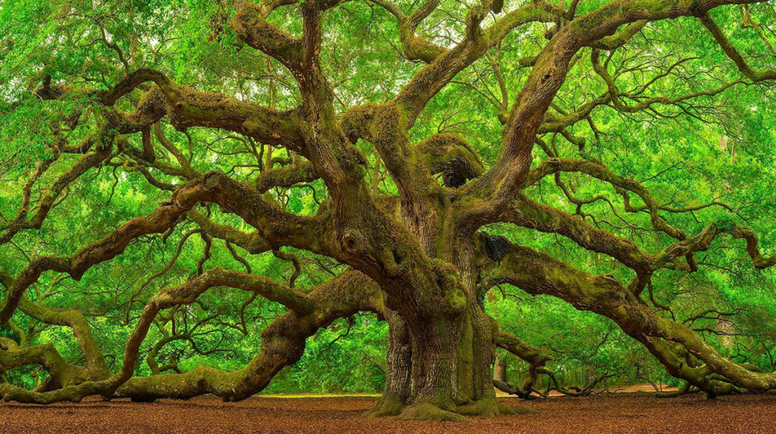
The only way you’re going to grow is by pushing yourself beyond what you think is possible. --David Goggins

Slide 137
also you were warned 🙂

Slide 138



Slide 139
how not to make a thing

Slide 140
how not to make a thing

Slide 141
note: this advice is like...just advice feel free to ignore (at your own peril) 🙂

Slide 142
project selection

Slide 143

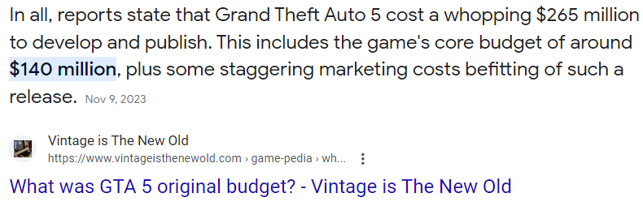
⚠ picking something really, really hard

Slide 144
⚠ picking something with a spooky progress curve
does it work?
deadline
time

Slide 145
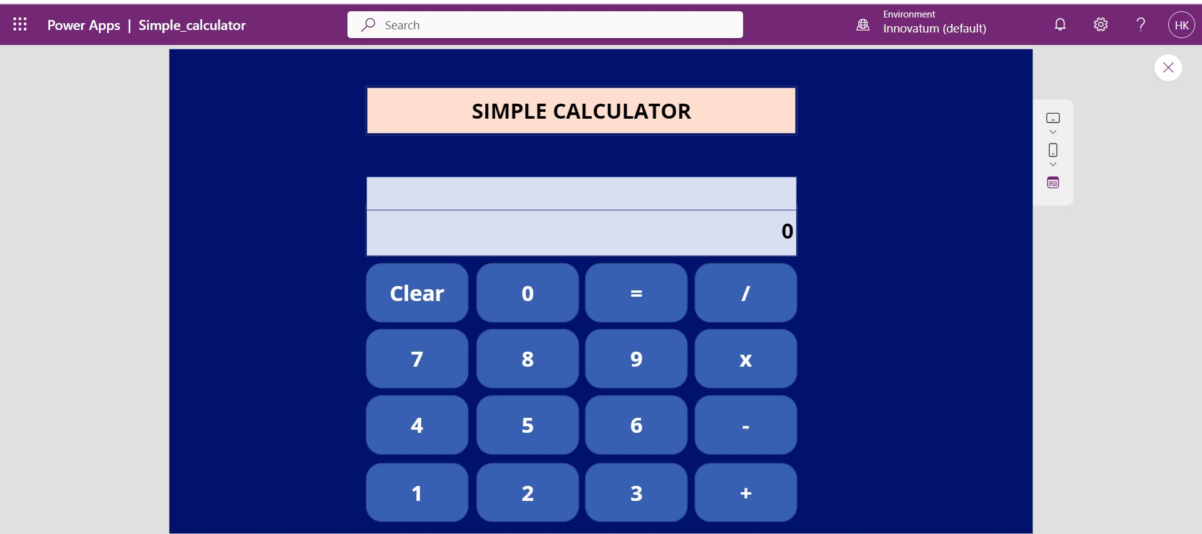
⚠ picking something you aren't really interested in (or can't really be extended)
note: though if you love calculators, go for it!

Slide 146
who (doesn't) have a final project idea? discuss amongst each other

Slide 147
focus (just make sudoku)

Slide 148
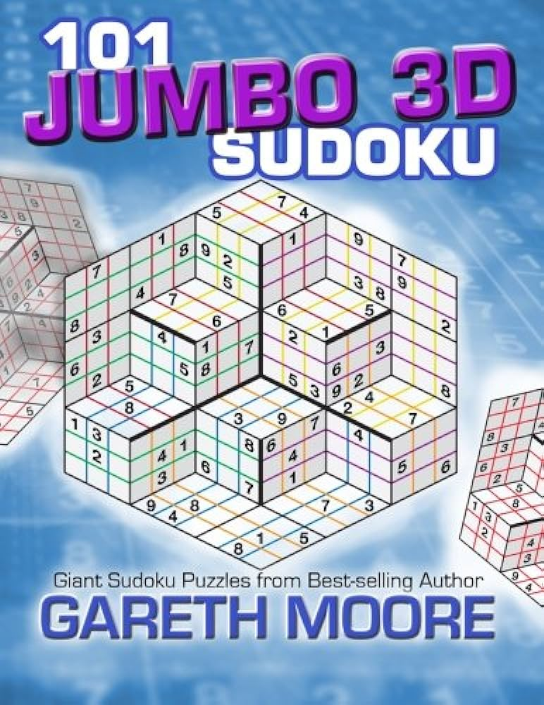
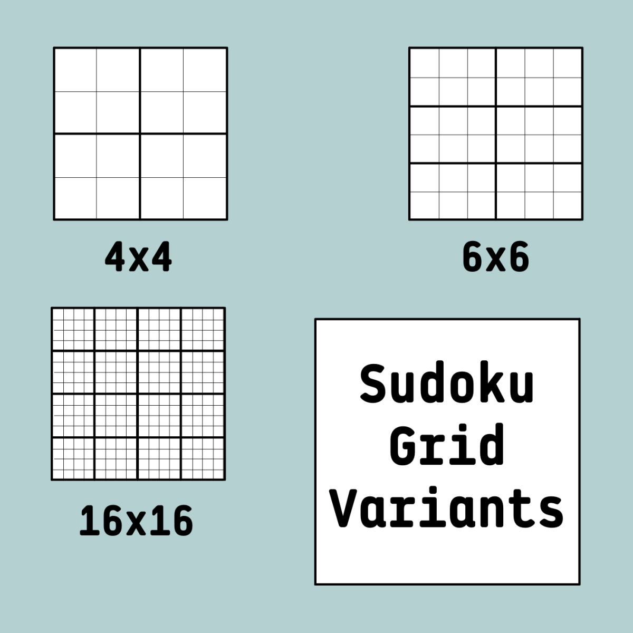
⚠ solving a more general problem than you need to
don't support arbitrary board sizes!
just make sudoku!
what?!

Slide 149
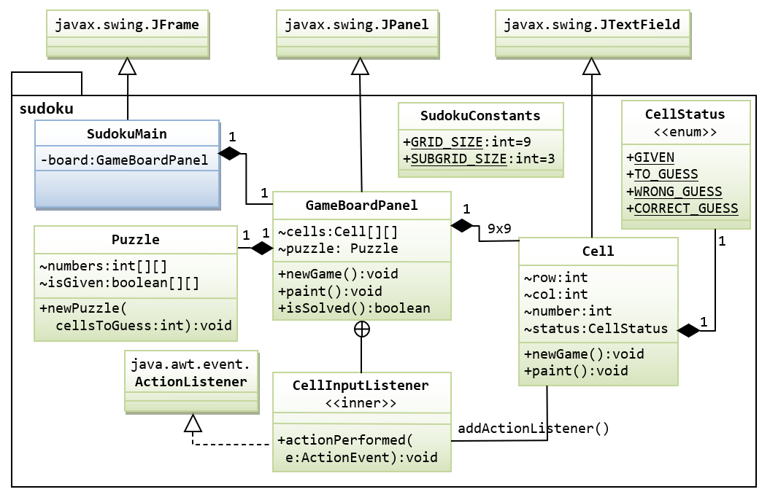
⚠ writing more general code than you need to
don't support multiple different kinds of puzzles
just make sudoku!

Slide 150

⚠ doing the fun part first
don't make a fun animated menu screen
just make sudoku!

Slide 151
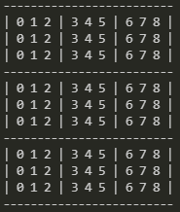
⚠ skipping development steps
consider making a board print to the terminal
before trying to get it working in Cow.java
consider just filling it with nonsense before filling it with a real board
consider hardcoding a starting board by hand
before implementing automatic board generation

Slide 152

then again, sometimes you just gotta go for it.

Slide 153
who (doesn't) know what they're going to implement first? discuss amongst each other

Slide 154
final thoughts

Slide 155
final thoughts
don't be afraid to write code
don't be afraid to delete code
don't be (too) afraid to fail
you will be graded primarily on effort

Slide 156
how are we feeling?

Slide 157
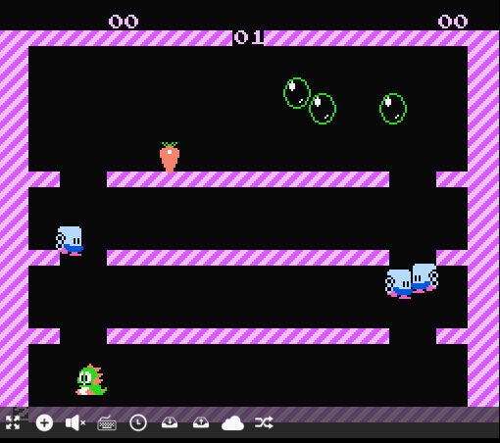
WARMUP
what is (0.1 + 0.1 + 0.1) ?
imagine you wanted to make this thing →
what would you implement 1st? 2nd?
what would you implement LAST? TODAY
who's to say
Bubble Bobble (NES)

Slide 158
Week10a
✨No Laptop Monday! ✨
binary search
binary search trees
WARMUP
how long does it take to find (search for) something in...
- an array list?
- a linked list?
what if the list is sorted?

Slide 159
[record lecture]

Slide 160
review: sorted

Slide 161
sorted

Slide 162
sorted
a sequence is sorted if its elements are "in order"
by convention, this means ascending order (going up from left to right)
[1, 2, 5, 6, 9, 13] is sorted
[9, 5, 1, 2, 6, 13] is unsorted (NOT sored)

Slide 163
search

Slide 164
search
to search means to look for something (in some data structure)
a simple search problem is finding a given value in an array / list
// get index of the first element in array with this value // returns -1 if value not found int find(int[] array, int value) { ... }
// Option B class FindResult { boolean success; int index; } FindResult find(int[] array, int value) { ... }

Slide 165
linear search (of an array / array list)

Slide 166
linear search (brute force search)
linear search looks at each element one by one
linear search works whether or not the list is sorted
linear search is O(n) (linear time) 😐
// get index of the first element in array with this value // returns -1 if value not found int linearSearch(int[] array, int value) { for (int i = 0; i < array.length; ++i) { if (array[i] == value) { return i; } } return -1; }

Slide 167
example: linear search for 17 [13 2 55 7 17 100 77]

Slide 168
example: linear search for 17 [13 2 55 7 17 100 77]

Slide 169
example: linear search for 17 [13 2 55 7 17 100 77]

Slide 170
example: linear search for 17 [13 2 55 7 17 100 77]

Slide 171
example: linear search for 17 [13 2 55 7 17 100 77]

Slide 172
example: linear search for 17 [13 2 55 7 17 100 77]

Slide 173
example: linear search for 17 [13 2 55 7 17 100 77]

Slide 174
example: linear search for 17 [13 2 55 7 17 100 77]

Slide 175
example: linear search for 17 [13 2 55 7 17 100 77]

Slide 176
example: linear search for 17 [13 2 55 7 17 100 77]

Slide 177
example: linear search for 17 [13 2 55 7 17 100 77]

Slide 179
example: linear search for 17 [1 2 4 5 6 8 9 10 11 13 15 16 17 18 19]

Slide 180
example: linear search for 17 [1 2 4 5 6 8 9 10 11 13 15 16 17 18 19]

Slide 181
example: linear search for 17 [1 2 4 5 6 8 9 10 11 13 15 16 17 18 19]

Slide 182
example: linear search for 17 [1 2 4 5 6 8 9 10 11 13 15 16 17 18 19]

Slide 183
example: linear search for 17 [1 2 4 5 6 8 9 10 11 13 15 16 17 18 19]

Slide 184
example: linear search for 17 [1 2 4 5 6 8 9 10 11 13 15 16 17 18 19]

Slide 185
example: linear search for 17 [1 2 4 5 6 8 9 10 11 13 15 16 17 18 19]

Slide 186
example: linear search for 17 [1 2 4 5 6 8 9 10 11 13 15 16 17 18 19]

Slide 187
example: linear search for 17 [1 2 4 5 6 8 9 10 11 13 15 16 17 18 19]

Slide 188
example: linear search for 17 [1 2 4 5 6 8 9 10 11 13 15 16 17 18 19]

Slide 189
example: linear search for 17 [1 2 4 5 6 8 9 10 11 13 15 16 17 18 19]

Slide 190
example: linear search for 17 [1 2 4 5 6 8 9 10 11 13 15 16 17 18 19]

Slide 191
example: linear search for 17 [1 2 4 5 6 8 9 10 11 13 15 16 17 18 19]

Slide 192
example: linear search for 17 [1 2 4 5 6 8 9 10 11 13 15 16 17 18 19]

Slide 193
example: linear search for 17 [1 2 4 5 6 8 9 10 11 13 15 16 17 18 19]

Slide 194
example: linear search for 17 [1 2 4 5 6 8 9 10 11 13 15 16 17 18 19]

Slide 195
example: linear search for 17 [1 2 4 5 6 8 9 10 11 13 15 16 17 18 19]

Slide 196
example: linear search for 17 [1 2 4 5 6 8 9 10 11 13 15 16 17 18 19]

Slide 197
example: linear search for 17 [1 2 4 5 6 8 9 10 11 13 15 16 17 18 19]

Slide 198
example: linear search for 17 [1 2 4 5 6 8 9 10 11 13 15 16 17 18 19]

Slide 199
example: linear search for 17 [1 2 4 5 6 8 9 10 11 13 15 16 17 18 19]

Slide 200
example: linear search for 17 [1 2 4 5 6 8 9 10 11 13 15 16 17 18 19]

Slide 201
example: linear search for 17 [1 2 4 5 6 8 9 10 11 13 15 16 17 18 19]

Slide 202
example: linear search for 17 [1 2 4 5 6 8 9 10 11 13 15 16 17 18 19]

Slide 203
example: linear search for 17 [1 2 4 5 6 8 9 10 11 13 15 16 17 18 19]

Slide 204
example: linear search for 17 [1 2 4 5 6 8 9 10 11 13 15 16 17 18 19]

Slide 205
example: linear search for 17 [1 2 4 5 6 8 9 10 11 13 15 16 17 18 19]

Slide 206
if we know that an array is sorted... can we search it faster?

Slide 207
yes 🚀

Slide 208
unless it's a linked list 💀

Slide 209
binary search (of a array / array list)

Slide 210
binary search
binary search is an O(log n) algorithm for searching a sorted array 🙂
binary search works by "cutting the array in half" over and over
☠️ binary search only applies if the array is sorted

Slide 211
example: binary search for 17 [1 2 4 5 6 8 9 10 11 13 15 16 17 18 19]

Slide 212
example: binary search for 17 [1 2 4 5 6 8 9 10 11 13 15 16 17 18 19]
10 < 17

Slide 213
example: binary search for 17 [1 2 4 5 6 8 9 10 11 13 15 16 17 18 19]

Slide 214
example: binary search for 17 [1 2 4 5 6 8 9 10 11 13 15 16 17 18 19]
16 < 17

Slide 215
example: binary search for 17 [1 2 4 5 6 8 9 10 11 13 15 16 17 18 19]

Slide 216
example: binary search for 17 [1 2 4 5 6 8 9 10 11 13 15 16 17 18 19]
17 < 18

Slide 217
example: binary search for 17 [1 2 4 5 6 8 9 10 11 13 15 16 17 18 19]

Slide 218
example: binary search for 17 [1 2 4 5 6 8 9 10 11 13 15 16 17 18 19]
17 == 17

Slide 219
example: binary search for 17 [1 2 4 5 6 8 9 10 11 13 15 16 17 18 19]

Slide 220
☠️ implementating binary search is surprisingly tricky! make sure you test thoroughly!

Slide 221
✨ hint: binary search [1 2 4 5 6 8 9 10 11 13 15 16 17 18 19]
[^ 2 4 5 6 8 9 10 11 13 15 16 17 18 ^ ]
[| 2 4 5 6 8 9 10 11 13 15 16 17 18 | ]
[i = 0 4 5 6 8 9 10 11 13 15 16 17 18 j ]

Slide 222
review: binary tree

Slide 223
binary tree

Slide 224
binary tree
a binary tree is a tree in which each node has <= 2 children
10
5
16
2
13
18
1
4
11
15
17

Slide 225
🧠 can a linked list be seen as a binary tree?

Slide 226
technically, yes (assuming no cycles) all nodes have <= 2 children (tail has 0 children, all other nodes have 1 child)

Slide 227
ordered binary tree

Slide 228
(ordered) binary tree
each node has a left child and a right child (either or both children can be null)
10
5
16
node
13
18
11
15
17
node.leftChild
node.rightChild

Slide 229
(ordered) binary tree
each node has a left subtree and a right subtree (and left descendants and right descendants)

Slide 230
binary search tree

Slide 231
binary search tree

Slide 232
binary search tree
in a binary search tree (BST, sorted binary tree) every node follows: "a node's value is greater than the values of all nodes in its left subtree and less than the values of all nodes in its right subtree"
10
5
16
2
13
18
1
4
11
15
17

Slide 233
binary search tree
in a binary search tree (BST, sorted binary tree) every node follows: "a node's value is greater than the values of all nodes in its left subtree and less than the values of all nodes in its right subtree"
10
10 < 16
5
16
5 < 10
2 < 10
10 < 13
2
13
18
10 < 18
1
4
10 < 11
11
15
17
10 < 17
4 < 10
1 < 10
10 < 15

Slide 234
binary search tree
in a binary search tree (BST, sorted binary tree) every node follows: "a node's value is greater than the values of all nodes in its left subtree and less than the values of all nodes in its right subtree"
10
5
16
13 < 16
2
13
18
16 < 18
1
4
11 < 16
11
15
17
16 < 17
15 < 16

Slide 235
binary search tree
in a binary search tree (BST, sorted binary tree) every node follows: "a node's value is greater than the values of all nodes in its left subtree and less than the values of all nodes in its right subtree"
10
5
16
2
13
18
1
4
11
15
17

Slide 236
is it a BST?

Slide 237
2
4
1
3
6
Is It A Binary Search Tree?
4
9
3
5
in a binary search tree (sorted binary tree) every node follows: "a node's value is greater than the values of all nodes in its left subtree and less than the values of all nodes in its right subtree"
2
1
10
5
16
2
8
13
18
1
4
6
9
14
15
17
19

Slide 238
2
4
1
3
6
4
9
3
5
in a binary search tree (sorted binary tree) every node follows: "a node's value is greater than the values of all nodes in its left subtree and less than the values of all nodes in its right subtree"
2
1
10
5
16
2
8
13
18
1
4
6
9
14
15
17
19

Slide 239
binary search (of a binary search tree)

Slide 240
binary search
binary search "cuts a BST in half" over and over
binary search only works when the binary tree is sorted (is a binary search tree)
binary search is O(log n) if the tree is "balanced" 🙂
balanced means each node's children are similar in height (intuitive understanding of this is sufficient; will discuss more on Fri)
10
10
5
16
5
2
8
13
18
2
1
6
9
11
9
1
balanced
NOT balanced

Slide 241
example: binary search for 17 [1 2 4 5 6 8 9 10 11 13 15 16 17 18 19]
10
5
16
2
8
13
18
1
4
6
9
11
15
17
19

Slide 242
example: binary search for 17 [1 2 4 5 6 8 9 10 11 13 15 16 17 18 19]
10
10 < 17
5
16
2
8
13
18
1
4
6
9
11
15
17
19

Slide 243
example: binary search for 17 [1 2 4 5 6 8 9 10 11 13 15 16 17 18 19]
10
5
16
2
8
13
18
1
4
6
9
11
15
17
19

Slide 244
example: binary search for 17 [1 2 4 5 6 8 9 10 11 13 15 16 17 18 19]
10
5
16
16 < 17
2
8
13
18
1
4
6
9
11
15
17
19

Slide 245
example: binary search for 17 [1 2 4 5 6 8 9 10 11 13 15 16 17 18 19]
10
5
16
2
8
13
18
1
4
6
9
11
15
17
19

Slide 246
example: binary search for 17 [1 2 4 5 6 8 9 10 11 13 15 16 17 18 19]
10
5
16
2
8
13
18
17 < 18
1
4
6
9
11
15
17
19

Slide 247
example: binary search for 17 [1 2 4 5 6 8 9 10 11 13 15 16 17 18 19]
10
5
16
2
8
13
18
1
4
6
9
11
15
17
19

Slide 248
example: binary search for 17 [1 2 4 5 6 8 9 10 11 13 15 16 17 18 19]
10
5
16
2
8
13
18
1
4
6
9
11
15
17
19
17 == 17

Slide 249
example: binary search for 17 [1 2 4 5 6 8 9 10 11 13 15 16 17 18 19]
10
5
16
2
8
13
18
1
4
6
9
11
15
17
19

Slide 250
note: a binary search tree is NOT unique let's look at another BST for the same data!

Slide 251
example: binary search for 17 [1 2 4 5 6 8 9 10 11 13 15 16 17 18 19]
2
1
4
5
6
8
9
10
11
13
15
16
17
18
19

Slide 252
example: binary search for 17 [1 2 4 5 6 8 9 10 11 13 15 16 17 18 19]
2
1
4
5
6
8
9
10
11
13
15
16
17
18
19

Slide 253
example: binary search for 17 [1 2 4 5 6 8 9 10 11 13 15 16 17 18 19]
2
1
4
5
6
8
9
10
11
13
15
16
17
18
19

Slide 254
example: binary search for 17 [1 2 4 5 6 8 9 10 11 13 15 16 17 18 19]
2
1
4
5
6
8
9
10
11
13
15
16
17
18
19

Slide 255
example: binary search for 17 [1 2 4 5 6 8 9 10 11 13 15 16 17 18 19]
2
1
4
5
6
8
9
10
11
13
15
16
17
18
19

Slide 256
example: binary search for 17 [1 2 4 5 6 8 9 10 11 13 15 16 17 18 19]
2
1
4
5
6
8
9
10
11
13
15
16
17
18
19

Slide 257
example: binary search for 17 [1 2 4 5 6 8 9 10 11 13 15 16 17 18 19]
2
1
4
5
6
8
9
10
11
13
15
16
17
18
19

Slide 258
example: binary search for 17 [1 2 4 5 6 8 9 10 11 13 15 16 17 18 19]
2
1
4
5
6
8
9
10
11
13
15
16
17
18
19

Slide 259
example: binary search for 17 [1 2 4 5 6 8 9 10 11 13 15 16 17 18 19]
2
1
4
5
6
8
9
10
11
13
15
16
17
18
19

Slide 260
...

Slide 261
life lesson: it is important that your binary search tree is ✨balanced✨ (otherwise your "binary search" degrades into linear search of a linked list ☹️)

Slide 262
adding a new node to a binary search tree (the naive (simple but bad) method)

Slide 263
for a binary search tree, add starts out just like search

Slide 264
just keep going until you hit a null node put the new node there 🙂👍

Slide 265
example: adding 7
10
5
16
2
8
13
18
1
4
6
9
11
15
17
19

Slide 266
example: adding 7
10
5
16
2
8
13
18
1
4
6
9
11
15
17
19

Slide 267
example: adding 7
10
5
16
2
8
13
18
1
4
6
9
11
15
17
19

Slide 268
example: adding 7
10
5
16
2
8
13
18
1
4
6
9
11
15
17
19

Slide 269
example: adding 7
10
5
16
2
8
13
18
1
4
6
9
11
15
17
19

Slide 270
example: adding 7
10
5
16
2
8
13
18
1
4
6
9
11
15
17
19
null

Slide 271
example: adding 7
10
5
16
2
8
13
18
1
4
6
9
11
15
17
19
7

Slide 272
example: adding 7
10
5
16
2
8
13
18
1
4
6
9
11
15
17
19
7

Slide 273
is this approach to adding a new node good? hint: no.

Slide 274
self-balancing binary search trees note: hard to implement

Slide 275


Slide 276
uses of binary search trees

Slide 277
tree map (implement a map)
you can implement the map interface using a BST NOTE: this is NOT a hash map!—no hashing is involved!
class Node {
String key; // NOTE: BST is sorted by key
Integer value;
Node leftChild;
Node rightChild;
}
class TreeMap { Node root;
ValueType get(KeyType) { ... }
void put(ValueType, KeyType) { ... }
}
"Ditto"
132
"Arbok"
24
"Mew"
151

Slide 278
Week10b
✨Wednesday! ✨
WARMUP
what does "sink or swim" mean?
BST traversal order review
heaps, heapsort
ANNOUNCEMENTS
Jim out of town Wed-Fri (TA's will run lab)
Tacos Tacos Tacos tomorrow at 7 pm

Slide 279
review: binary tree depth-first traversal orders

Slide 280
binary tree depth-first traversal orders

Slide 281
depth-first traversal orders (of a binary tree)
pre-order = self, left, right
3, 1, 0, 2, 5, 4, 6
in-order = left, self, right
0, 1, 2, 3, 4, 5, 6
post-order = left, right, self
0, 2, 1, 4, 6, 5, 3
reverse pre-order = self, right, left
3, 5, 6, 4, 1, 2, 0
reverse in-order = right, self, left
6, 5, 4, 3, 2, 1, 0
reverse post-order = right, left, self
6, 4, 5, 2, 0, 1, 3
3
1
5
0
2
4
6

Slide 282
2 * 3
+ 4
who's that
traversal order?
+
in-order!
*
4
2
3

Slide 283
the most satisfying function in CS 136
void recurse(Node self) {
// NOTE: rearranging these 3 lines gives you all
// 3! ("three factorial") = 6 traversal orders
if (self.leftChild != null) { recurse(self.leftChild); }
System.out.print(self.value + " ");
if (self.rightChild != null) { recurse(self.rightChild); }
}

Slide 284
[Live-code traversal orders] (Feel free to follow along or race.)

Slide 285
heaps

Slide 286
always-complete max binary heap

Slide 287
always-complete max binary heap
in this class, when we say "heap" or "max heap", we mean an "always-complete max binary heap"
we might occasionally mention a "min heap", which means an "always-complete min binary heap"

Slide 288
always-complete max binary heap
in a complete binary tree, all levels (depths, rows) are "full of nodes", except for possibly the bottom level, in which all nodes are "as far to to the left as possible"
10
10
5
16
5
16
2
8
13
18
2
8
13
18
1
4
6
9
11
1
4
6
11
complete
(and balanced)
balanced but NOT complete

Slide 289
always-complete max binary heap
in a complete binary tree, all levels (depths) are "full of nodes", except for possibly the bottom level, in which all nodes are "as far to to the left as possible"
10
5
16
2
8
13
18
1
4
6
9
the "last node"
complete
(and balanced)

Slide 290
always-complete max binary heap
"always-complete" means that every function in the Heap interface (add(...) & remove()) "preserves the completeness of the heap"
the heap was complete before calling add...
...and the heap is still complete after add returns
the heap is always complete
always complete.

Slide 291
always-complete max binary heap
a binary heap is another special kind of binary tree
☠️ a binary heap is NOT, in general, a binary search tree

Slide 292
always-complete max binary heap
in a max binary heap, every node follows: "a node's value is greater than the value of its left child and the value of its right child"
27
15
5
7
13
4
2
6
3
11
12
1

Slide 293
always-complete max binary heap
in a max binary heap, every node follows: "a node's value is greater than the value of its left child and the value of its right child"
27
27 > 15
27 > 5
15
5
7
13
4
2
6
3
11
12
1

Slide 294
always-complete max binary heap
in a max binary heap, every node follows: "a node's value is greater than the value of its left child and the value of its right child"
27
15
5
7
13
4
2
6
3
11
12
1
7 > 6
7 > 3

Slide 295
always-complete max binary heap
in a max binary heap, every node follows: "a node's value is greater than the value of its left child and the value of its right child"
🧠 is the "max heap property" above equivalent to...
in a max binary heap, every node follows: "a node's value is greater than the values of all its descendants"
yes.
idea: apply definition recursively
node's value is greater than the values of its children... ...which are greater than the values of their children...
🧠 which node always has the max value of all nodes in the heap?
the root

Slide 296
always-complete max binary heap
in a max binary heap, every node follows: "a node's value is greater than the values of all its descendants"
27
15
5
15 > 7
7
15 > 13
13
4
2
6
3
11
12
1
15 > 6
15 > 3
15 > 11
15 > 12

Slide 297
heap interface add(...) & remove() 🐡 ⚓️ a heap is like a benthic trawl net (ish)

Slide 298
heap interface
// Add this value to the heap. void add(ValueType value) { ... }
// Remove the max value from the heap, and return it. ValueType remove() { ... }

Slide 299
add(...)

Slide 300
void add(ValueType value);
to add a new node with a given value to a max binary heap...
add the new node so that the heap is still complete (add into "the next empty slot")
while that node violates the max heap property...
swap it with its parent
the node "swims up" 🐡
"sifts up"
"heap up"?

Slide 301
example: adding 10
27
15
5
7
13
4
2
6
3
11
12
1

Slide 302
example: adding 10
27
15
5
7
13
4
2
6
3
11
12
1

Slide 303
example: adding 10
27
15
5
7
13
4
2
6
3
11
12
1
10

Slide 304
example: adding 10
27
15
5
7
13
4
2
6
3
11
12
1
10

Slide 305
example: adding 10
27
15
5
7
13
4
2
6
3
11
12
1
10

Slide 306
example: adding 10
27
15
5
7
13
10
2
6
3
11
12
1
4

Slide 307
example: adding 10
27
15
5
7
13
10
2
6
3
11
12
1
4

Slide 308
example: adding 10
27
15
5
7
13
10
2
6
3
11
12
1
4

Slide 309
example: adding 10
27
15
5
7
13
10
2
6
3
11
12
1
4

Slide 310
example: adding 10
27
15
10
7
13
5
2
6
3
11
12
1
4

Slide 311
example: adding 10
27
15
10
7
13
5
2
6
3
11
12
1
4

Slide 312
example: adding 10
27
15
10
7
13
5
2
6
3
11
12
1
4

Slide 313
example: adding 10
27
15
10
7
13
5
2
6
3
11
12
1
4

Slide 314
example: adding 10
27
15
10
7
13
5
2
6
3
11
12
1
4

Slide 315
remove()

Slide 316
ValueType remove();
to remove the node with max value (the root) from a max binary heap...
save the root's value in a temporary variable called result
replace the root with the last node (rightmost node in the bottom level) (the old root is now "garbage" and ready to be garbage collected 🚛)
while that node violates the max heap property...
swap it with its larger child
return result;
the node "sinks down" ⚓️
"sifts down"
"heap down"?

Slide 317
example: removing max node
27
15
5
7
13
4
2
6
3
11
0
1

Slide 318
example: removing max node
int result = root.value;
27
15
5
7
13
4
2
6
3
11
0
1

Slide 319
example: removing max node
27
15
5
7
13
4
2
6
3
11
0
1

Slide 320
example: removing max node
27
15
5
7
13
4
2
6
3
11
0
1

Slide 321
example: removing max node
1
15
5
7
13
4
2
6
3
11
0

Slide 322
example: removing max node
1
15
5
7
13
4
2
6
3
11
0

Slide 323
example: removing max node
1
15
5
7
13
4
2
6
3
11
0

Slide 324
example: removing max node
1
15
5
7
13
4
2
6
3
11
0

Slide 325
example: removing max node
15
1
5
7
13
4
2
6
3
11
0

Slide 326
example: removing max node
15
1
5
7
13
4
2
6
3
11
0

Slide 327
example: removing max node
15
1
5
7
13
4
2
6
3
11
0

Slide 328
example: removing max node
15
1
5
7
13
4
2
6
3
11
0

Slide 329
example: removing max node
15
1
5
7
13
4
2
6
3
11
0

Slide 330
example: removing max node
15
13
5
7
1
4
2
6
3
11
0

Slide 331
example: removing max node
15
13
5
7
1
4
2
6
3
11
0

Slide 332
example: removing max node
15
13
5
7
1
4
2
6
3
11
0

Slide 333
example: removing max node
15
13
5
7
1
4
2
6
3
11
0

Slide 334
example: removing max node
15
13
5
7
11
4
2
6
3
1
0

Slide 335
example: removing max node
15
13
5
7
11
4
2
6
3
1
0

Slide 336
example: removing max node
15
13
5
7
11
4
2
6
3
1
0

Slide 337
example: removing max node
15
13
5
7
11
4
2
6
3
1
0

Slide 338
example: removing max node
15
13
5
7
11
4
2
6
3
1
0
return result;

Slide 339
(implicit) heapsort

Slide 340

because a heap is an always-complete binary tree, we can store a heap "implicitly" as an array using a breadth-first (level-order) traversal!
[ 9 8 7 6 4 1 2 3 5 ]
9
8
7
6
4
1
2
3
5

Slide 341
this lets us do (in-place) implicit heapsort! (using only swaps)

Slide 342
1. build a heap by calling add(...) over and over 2. deconstruct the heap by calling remove() over and over

Slide 343
[ 7 3 2 4 6 1 8 5 9 ]

Slide 344
[ 7 3 2 4 6 1 8 5 9 ]
7

Slide 345
[ 7 3 2 4 6 1 8 5 9 ]
7
3

Slide 346
[ 7 3 2 4 6 1 8 5 9 ]
7
3
2

Slide 347
[ 7 3 2 4 6 1 8 5 9 ]
7
3
2
🐡
4

Slide 348
[ 7 4 2 3 6 1 8 5 9 ]
7
💦
4
2
3

Slide 349
[ 7 4 2 3 6 1 8 5 9 ]
7
4
2
3

Slide 350
[ 7 4 2 3 6 1 8 5 9 ]
7
4
2
🐡
3
6

Slide 351
[ 7 6 2 3 4 1 8 5 9 ]
7
6
💦
2
3
4

Slide 352
[ 7 6 2 3 4 1 8 5 9 ]
7
6
2
3
4

Slide 353
[ 7 6 2 3 4 1 8 5 9 ]
7
6
2
3
4
1

Slide 354
[ 7 6 2 3 4 1 8 5 9 ]
7
6
2
🐡
3
4
1
8

Slide 355
[ 7 6 8 3 4 1 2 5 9 ]
7
🐡
6
8
3
4
1
2

Slide 356
[ 8 6 7 3 4 1 2 5 9 ]
8
💦
6
7
3
4
1
2

Slide 357
[ 8 6 7 3 4 1 2 5 9 ]
8
6
7
3
4
1
2

Slide 358
[ 8 6 7 3 4 1 2 5 9 ]
8
6
7
3
4
1
2
🐡
5

Slide 359
[ 8 6 7 5 4 1 2 3 9 ]
8
6
7
💦
5
4
1
2
3

Slide 360
[ 8 6 7 5 4 1 2 3 9 ]
8
6
7
5
4
1
2
3

Slide 361
[ 8 6 7 5 4 1 2 3 9 ]
8
6
7
5
4
1
2
🐡
3
9

Slide 362
[ 8 6 7 9 4 1 2 3 5 ]
8
6
7
🐡
9
4
1
2
3
5

Slide 363
[ 8 9 7 6 4 1 2 3 5 ]
8
🐡
9
7
6
4
1
2
3
5

Slide 364
[ 9 8 7 6 4 1 2 3 5 ]
💦
9
8
7
6
4
1
2
3
5

Slide 365
[ 9 8 7 6 4 1 2 3 5 ]
9
8
7
6
4
1
2
3
5

Slide 366
[ 9 8 7 6 4 1 2 3 5 ]
9
8
7
6
4
1
2
3
5

Slide 367
[ 5 8 7 6 4 1 2 3 9 ]
⚓️
5
8
7
6
4
1
2
3

Slide 368
[ 8 5 7 6 4 1 2 3 9 ]
8
⚓️
5
7
6
4
1
2
3

Slide 369
[ 8 6 7 5 4 1 2 3 9 ]
8
6
7
💦
5
4
1
2
3

Slide 370
[ 8 6 7 5 4 1 2 3 9 ]
8
6
7
5
4
1
2
3

Slide 371
[ 8 6 7 5 4 1 2 3 9 ]
8
6
7
5
4
1
2
3

Slide 372
[ 3 6 7 5 4 1 2 8 9 ]
3
⚓️
6
7
5
4
1
2

Slide 373
[ 7 6 3 5 4 1 2 8 9 ]
7
💦
6
3
5
4
1
2

Slide 374
[ 7 6 3 5 4 1 2 8 9 ]
7
6
3
5
4
1
2

Slide 375
[ 7 6 3 5 4 1 2 8 9 ]
7
6
3
5
4
1
2

Slide 376
[ 2 6 3 5 4 1 7 8 9 ]
⚓️
2
6
3
5
4
1

Slide 377
[ 6 2 3 5 4 1 7 8 9 ]
6
⚓️
2
3
5
4
1

Slide 378
[ 6 5 3 2 4 1 7 8 9 ]
6
5
3
💦
2
4
1

Slide 379
[ 6 5 3 2 4 1 7 8 9 ]
6
5
3
2
4
1

Slide 380
[ 6 5 3 2 4 1 7 8 9 ]
6
5
3
2
4
1

Slide 381
[ 1 5 3 2 4 6 7 8 9 ]
⚓️
1
5
3
2
4

Slide 382
[ 5 1 3 2 4 6 7 8 9 ]
5
1
⚓️
3
2
4

Slide 383
[ 5 4 3 2 1 6 7 8 9 ]
5
4
3
💦
2
1

Slide 384
[ 5 4 3 2 1 6 7 8 9 ]
5
4
3
2
1

Slide 385
[ 5 4 3 2 1 6 7 8 9 ]
5
4
3
2
1

Slide 386
[ 1 4 3 2 5 6 7 8 9 ]
⚓️
1
4
3
2

Slide 387
[ 4 1 3 2 5 6 7 8 9 ]
4
⚓️
1
3
2

Slide 388
[ 4 2 3 1 5 6 7 8 9 ]
4
2
3
💦
1

Slide 389
[ 4 2 3 1 5 6 7 8 9 ]
4
2
3
1

Slide 390
[ 4 2 3 1 5 6 7 8 9 ]
4
2
3
1

Slide 391
[ 1 2 3 4 5 6 7 8 9 ]
1
⚓️
2
3

Slide 392
[ 3 2 1 4 5 6 7 8 9 ]
3
💦
2
1

Slide 393
[ 3 2 1 4 5 6 7 8 9 ]
3
2
1

Slide 394
[ 3 2 1 4 5 6 7 8 9 ]
3
2
1

Slide 395
[ 1 2 3 4 5 6 7 8 9 ]
⚓️
1
2

Slide 396
[ 2 1 3 4 5 6 7 8 9 ]
2
💦
1

Slide 397
[ 2 1 3 4 5 6 7 8 9 ]
2
1

Slide 398
[ 2 1 3 4 5 6 7 8 9 ]
2
1

Slide 399
[ 1 2 3 4 5 6 7 8 9 ]
1

Slide 400
[ 1 2 3 4 5 6 7 8 9 ]
1

Slide 401
[ 1 2 3 4 5 6 7 8 9 ]
1

Slide 402
[ 1 2 3 4 5 6 7 8 9 ]

Slide 403
heap application: priority queue

Slide 404

review: queue
remove();

Slide 405
review: queue
remove();

Slide 406
review: queue
add();

Slide 407
review: queue
add();

Slide 408
review: queue
remove();

Slide 409
review: queue

Slide 410
extension: priority queue

Slide 411

extension: priority queue

Slide 412

extension: priority queue
priority 1

Slide 413

extension: priority queue
priority 1
priority 1

Slide 414

extension: priority queue
priority 9
priority 1
priority 1

Slide 415

extension: priority queue
priority 9
priority 1
priority 1
priority 5

Slide 416

extension: priority queue
priority 999
priority 9
priority 1
priority 1
priority 5

Slide 417
extension: priority queue
priority 999
priority 9
priority 1
priority 1
priority 5

Slide 418
a priority queue's remove() function removes the element with highest priority

Slide 419
a max heap's remove() function removes the node with maximum value

Slide 420
✨ a max heap is a natural way to implement a priority queue ✨

Slide 421
Week09a
✨No Laptop Monday Funday! ✨
🦜🦜🦜
🦜🦜🦜
🦜🦜🦜
directed graph preview
trees
BOTANY WARMUP
what is a tree?
what is a branch?
what is a node?
ADDITIONAL WARMUP
what does binary mean?
what is a binary tree?
what does ternary mean?
[record lecture]

Slide 422
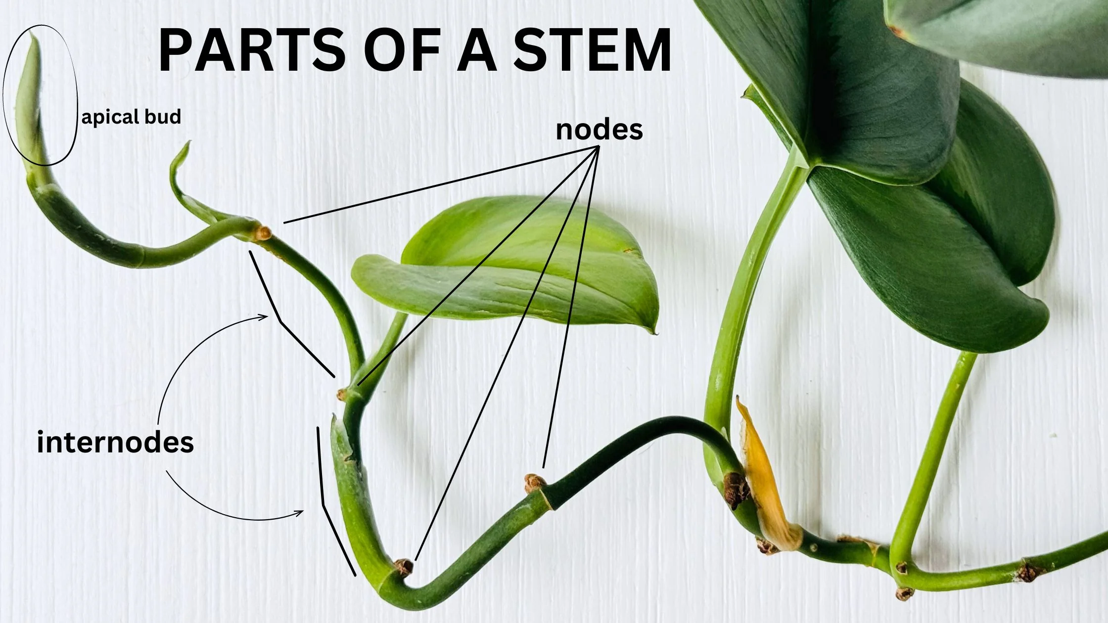

Slide 423
directed graphs

Slide 424
quick note: Math vs. CS

Slide 425
CS vs. Math
a directed graph is a data structure
it has nodes that refer to any number of other nodes
a directed graph G = (V, E) is also a mathematical object
it has vertices (nodes) V
it has directed edges E
note: E is a set of 2-tuples

Slide 426
these are really just two different ways of looking at the same thing

Slide 427
both are useful! (Math to figure out the algorithm, CS to code it up)

Slide 428
in CSCI 136, i will focus on the CS view (MATH 200, CSCI 256 will look at the Math side)

Slide 429
🙂👍

Slide 430
directed graph

Slide 431
the directed graph generalizes the linked list
a node in a directed graph has references to any number of other nodes
nodes are drawn as circles
references are drawn as arrows
let's not worry about
whether this is allowed
or whether this is allowed

Slide 432
(whether we allow for self-edges, multiple edges, etc. depends on context)

Slide 433
🙂👍

Slide 434
tree

Slide 435
kinship terminology (parent, child, etc.)

Slide 436
kinship terminology is useful for describing trees
a node has references to other nodes
it is their parent
they are its children

Slide 437
(directed) tree

Slide 438
a (directed) tree is a directed graph that...
has exactly one node with zero parents (the root)
has no nodes with more than one parent
has no cycles (loops) of any kind
is connected (just one tree, not multiple disconnected trees)
(otherwise, it would be a forest)
5
16
2
2
2
13
18
1
4
11
15
19

Slide 439
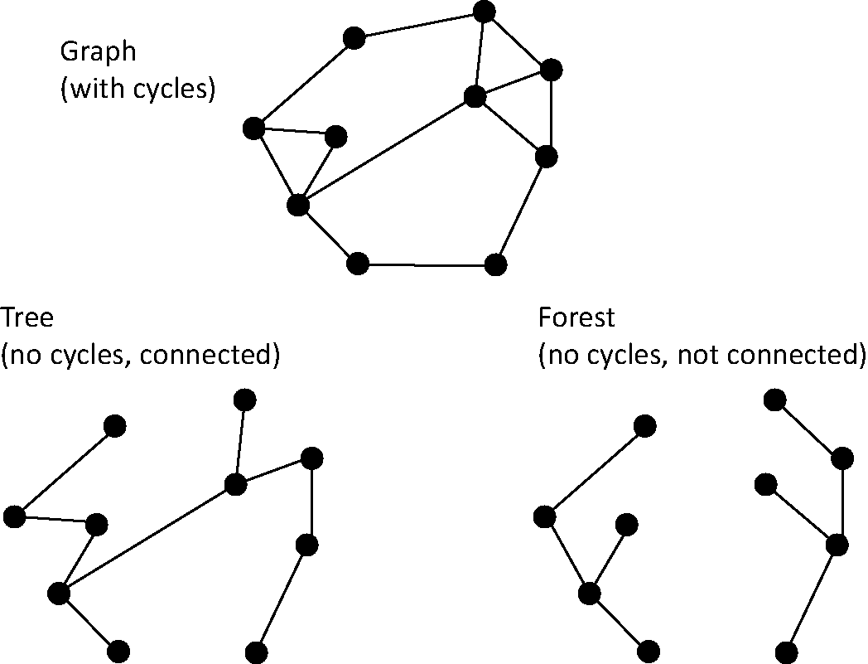
note: not joking

Slide 440
Monday Funday

Slide 441
time for everyone's favorite home game...

Slide 442
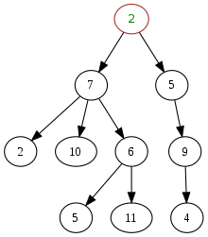
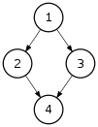
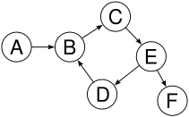
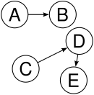

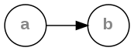
is it a tree?
yes
no
violates 2 & 3
tree rules
exactly one node with zero parents
no node with more than one parent
no cycles
is connected
no
violates 2 & 3
no
violates 1 & 4
no
violates 1 & 3
yes

Slide 443
is it a tree?
yes

Slide 444

can be seen as

Slide 445
uses of trees

Slide 446
simplifying expressions

Slide 447
(2 + 3)
* 4
*
+
4
2
3

Slide 448
5
* 4
*
5
4

Slide 449
20
20

Slide 450
!
(true && )
(false || true)
!
&&
true
||
false
true

Slide 451
!
(true && true)
!
&&
true
true

Slide 452
!true
!
true

Slide 453
false
false

Slide 454
and so much more!

Slide 455
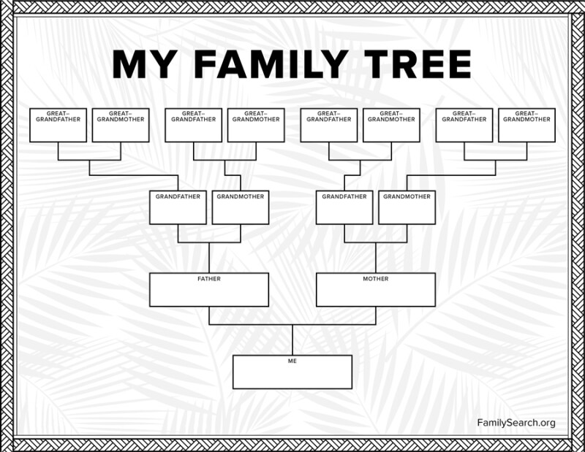

Slide 456
careful: these nodes are
the children of
the node with value jim
jim
jim's mom
jim's dad
jim's mom's mom
jim's mom's dad
jim's dad's mom
jim's dad's dad

Slide 457
note: family trees considered deeply confusing; let us never talk of them again 🙅

Slide 458
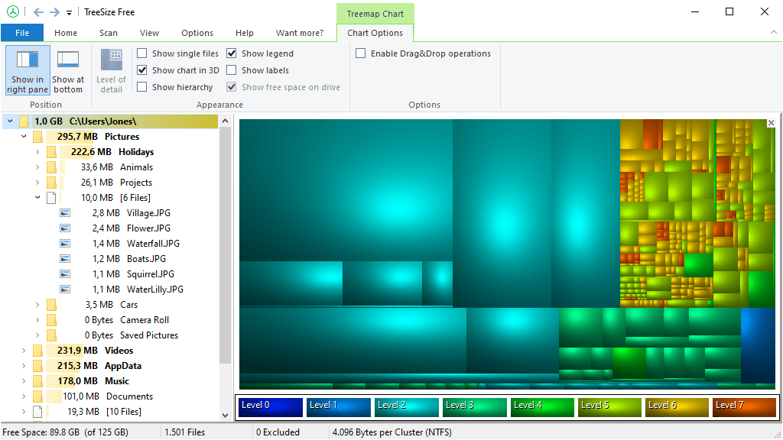
File System (TreeSize Free)
https://www.jam-software.com/treesize_free

Slide 459
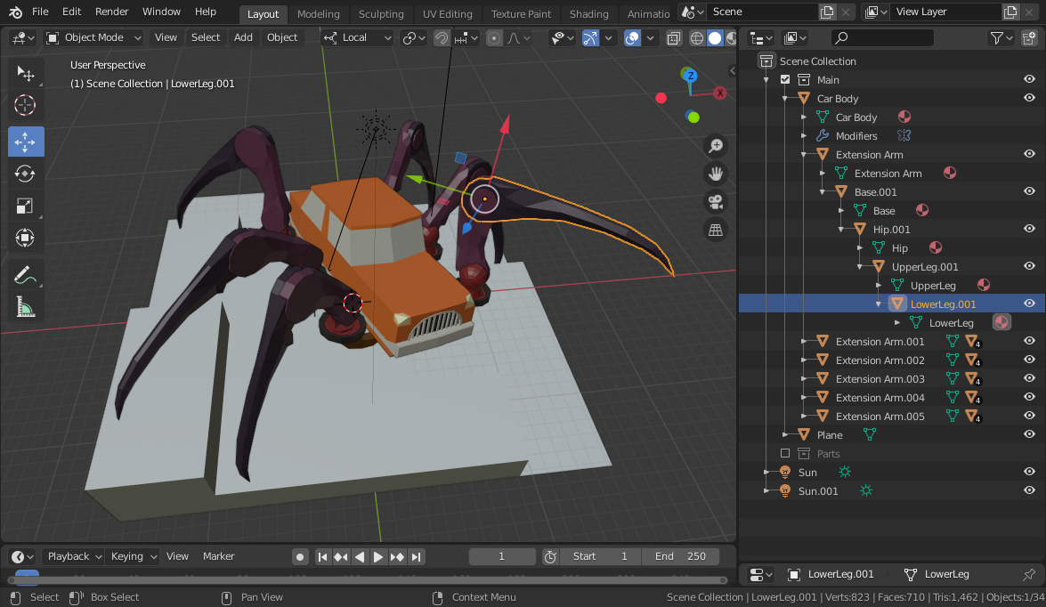
Transformation Hierarchy (Blender)
https://15466.courses.cs.cmu.edu/lesson/hierarchy

Slide 460
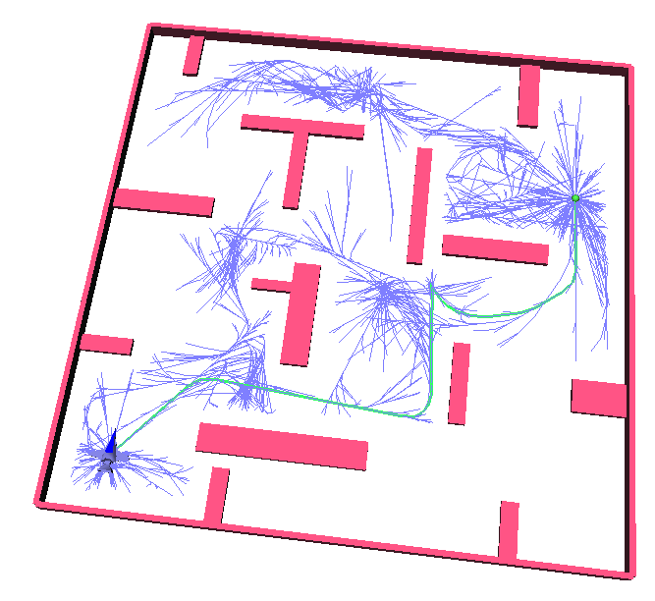
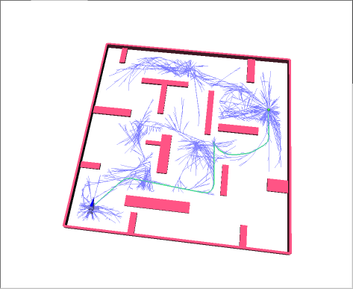
Rapidly Exploring Random Trees (RRTs)
Randomized Kinodynamic Planning by Steven M. LaValle and James J. Kuffner, Jr., International Journal of Robotics Research, 20(5):378--400, May 2001

Slide 461
Hierplane (Mark)

Slide 462
[homework preview]

Slide 463
different ways to implement trees

Slide 464
ArrayList<Node> children; Node leftChild; Node rightChild; Node[] children;

Slide 465
Week09b
✨Laptop Wednesday! ✨
for-each loop
tree terminology
terrific tree traversal tutorial
BONUS WARMUP
evaluate this expression tree
🦜🦜🦜
🦜🦜🦜
🦜🦜🦜
WARMUP
what does depth mean?
what does breadth mean?
what does first mean?

Slide 466
[address the election?]

Slide 467
[record lecture]

Slide 468
☠️ for-each loop

Slide 469
☠️ for-each loop

Slide 470
🐍 Python's for loop is a for-each loop
lst = [ True, 5.0, "Hello" ]
for element in lst: # for each item in the list...
print(element)

Slide 471
a for-each loop can be a convenient alternative to a for loop
for (int turretIndex = 0; turretIndex < turrets.length; ++turretIndex) {
Turret turret = turrets[turretIndex];
...
}
for (Turret turret : turrets) { // for each turret in turrets...
...
}

Slide 472
a for-each loop can be a convenient alternative to a for loop
for (int strokeIndex = 0; strokeIndex < currentFrame.size(); ++strokeIndex) {
ArrayList<Point> stroke = currentFrame.get(strokeIndex);
for (int pointIndex = 0; pointIndex < stroke.size(); ++pointIndex) {
Point point = stroke.get(pointIndex);
...
}
}
for (ArrayList<Point> stroke : currentFrame) {
for (Point point : stroke) {
...
}
}
forgive me 🥲
i swear all that indexing built character

Slide 473
for-each can be convenient but...

Slide 474
you never *need* a for-each loop (some languages don't even have one)

Slide 475
☠️ for-each loops can get you into trouble if you don't fully understand how references and Objects work in Java

Slide 476
☠️ for-each loop dangers
☠ a for-each loop provides a "convenient reference"
☠ LESS powerful than a regular for loop
for (int i = 0; i < things.length; ++i) {
Thing thing = things[i]; // thing is a "convenient reference"
...
}
for (Thing thing : things) { // thing is a "convenient reference"
...
}

Slide 477
☠️ for-each loop dangers
for (int i = 0; i < things.length; ++i) {
things[i] = new Thing(); // does write to array 🙂👍
}
for (int i = 0; i < things.length; ++i) {
Thing thing = things[i]; // thing is a "convenient reference"
thing = new Thing(); // does NOT write to array
}
for (Thing thing : things) { // thing is a "convenient reference"
thing = new Thing(); // does NOT write to array
}

Slide 478
☠️ for-each loop for iterating over a String
in Java, a for-each loop can iterate through String's with toCharArray()
☠ toCharArray() is O(n), but fine for CSCI 136
for (char c : string.toCharArray()) {
...
}

Slide 479
more tree terminology

Slide 480
more tree terminology

Slide 483
the root has no parents a leaf has no children
root
5
16
2
13
18
leaves

Slide 484
a path is a chain of distinct edges
16
path
13
18

Slide 485
a node's depth is the number of edges in the path from the root to that node
depth 0
5
16
depth 1
2
13
18
depth 2
depth 3

Slide 486
level means either depth or (depth + 1) depending on who you ask 🤷‍♀️

Slide 487
tree traversal

Slide 488
breadth-first vs. depth-first

Slide 489

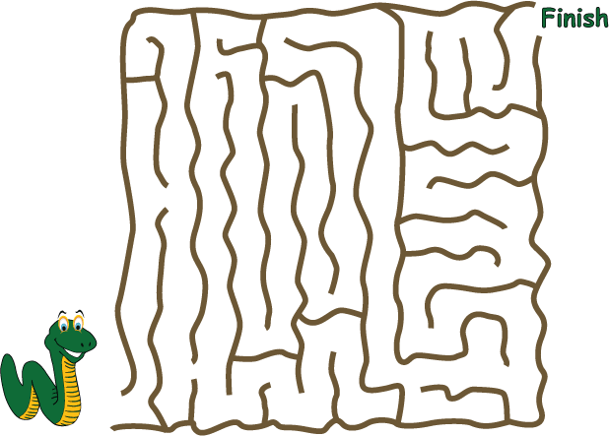
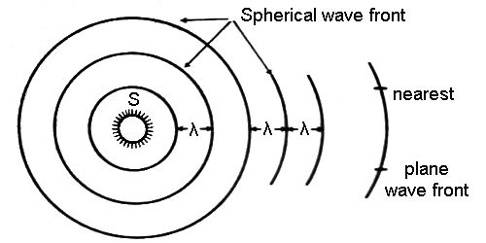
breadth-first vs. (pre-order) depth-first
"a persistent, optimistic, very thorough worm" –Mark Hopkins

Slide 490
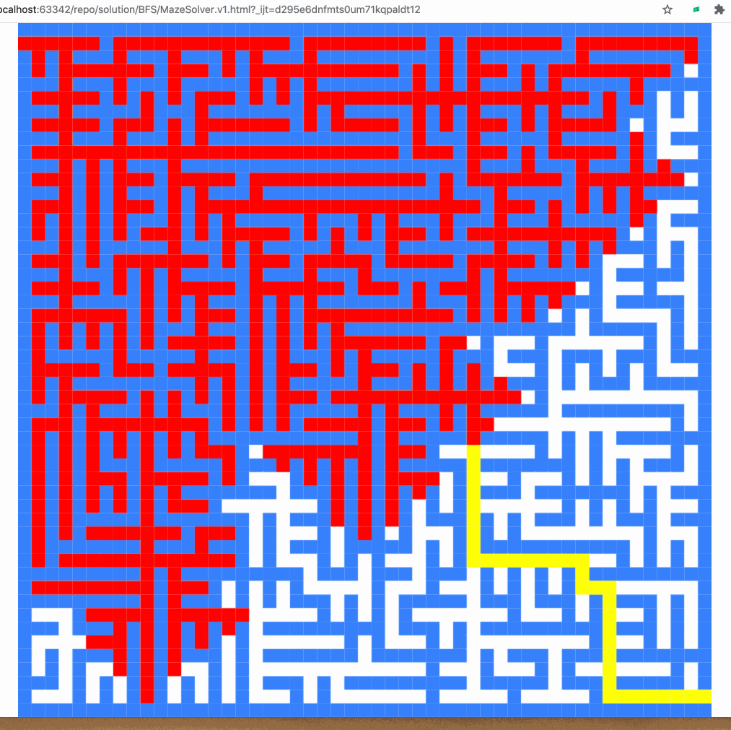
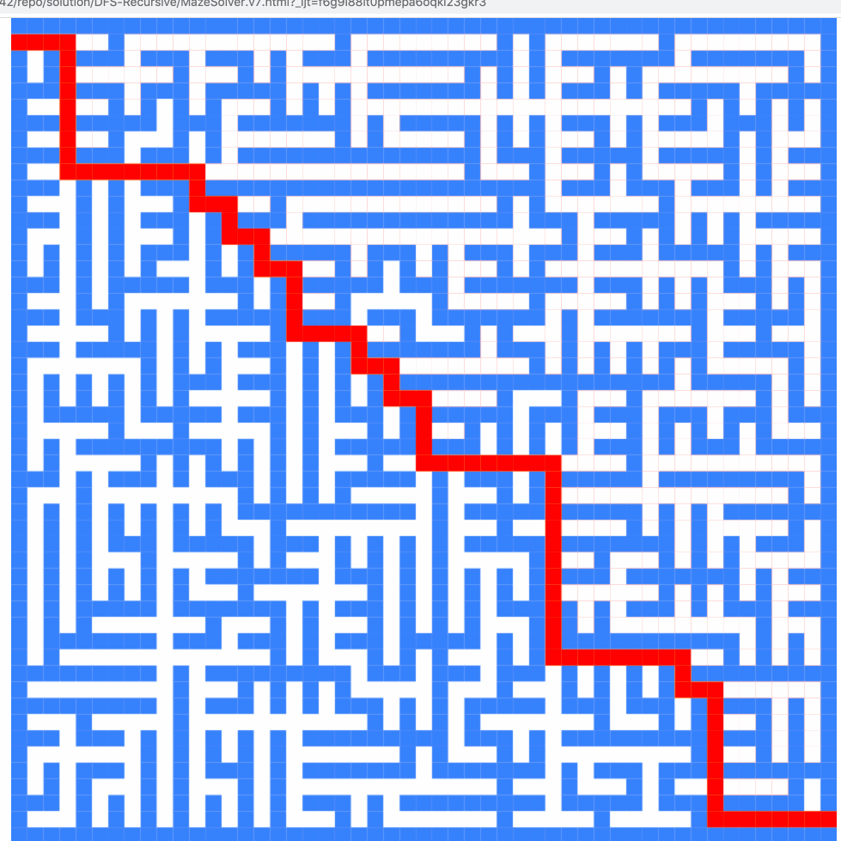
breadth-first vs. (pre-order) depth-first

Slide 491
breadth-first vs. (pre-order) depth-first
0
0
1
2
3
1
2
3
4
5
4
5
6
6
0
1
2
3
4
5
6
0
1
4
6
5
2
3

Slide 492
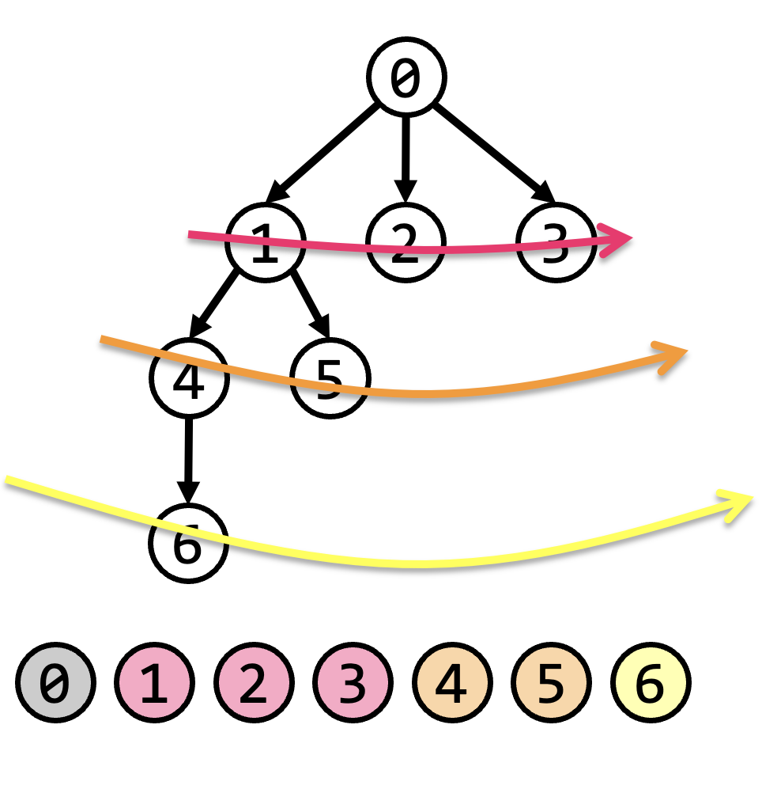
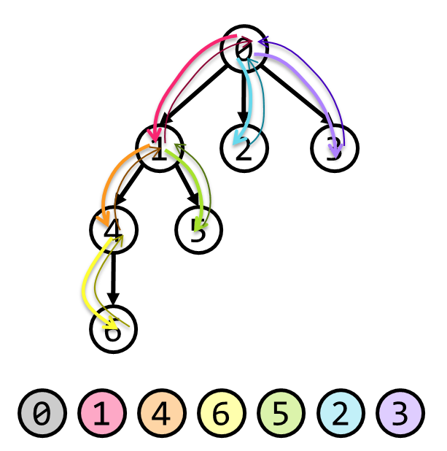
tree traversal (walking the tree)
tree traversal means iterating through all of the tree's nodes
breadth-first first explores as broadly (widely) as possible
one level (depth) at a time
uses a queue
depth-first first explores as deeply as possible
one root-to-leaf path at a time
uses a stack (or recursion, which uses the callstack)
☠ there are actually many different variants of depth-first traversal (i will explain them when we get to binary trees)

Slide 493
why might we want to traverse a tree? why did we want to traverse a linked list? do we ever *traverse* an array?

Slide 494
gathering all words in a trie (HW09)
searching for something (HW10?)
evaluating an expression tree
gathering all the nodes into a list (Tut09)

Slide 495
Terrific Tree Traversal Tutorial

Slide 496
explanation

Slide 497
Week09c
Friday.
trees vs. graphs
WARMUP
have you ever played the game Worms World Party?
how would you implement it?

Slide 498
[record lecture]

Slide 499
Terrific Tree Traversal Tutorial treview

Slide 500
traverseBreadthFirst
change color to indicate
hasBeenVisited = true
0 added to queue
0 removed from queue
1 added to queue
2 added to queue
3 added to queue
1 removed from queue
4 added to queue
5 added to queue
2 removed from queue
3 removed from queue
6 added to queue
4 removed from queue
5 removed from queue
6 removed from queue
7 added to queue
7 removed from queue
0
1
2
3
4
5
6
queue.add(root)
while queue not empty:
curr = queue.remove()
... # process curr
for child in curr.children:
queue.add(child)
7
0
1
2
3
4
5
6
7

Slide 501
traversePreOrderDepthFirst
change color to indicate
hasBeenVisited = true
start recurse(0)
start recurse(1)
start recurse(4)
finish recurse(4)
start recurse(5)
finish recurse(5)
finish recurse(1)
start recurse(2)
finish recurse(2)
start recurse(3)
start recurse(6)
start recurse(7)
finish recurse(7)
finish recurse(6)
finish recurse(3)
finish recurse(0)
0
1
2
3
4
5
6
def recurse(curr):
... # process curr
for child in curr.children:
recurse(child)
7
recurse(root)
0
1
4
5
2
3
6
7

Slide 502
example: two a-maze-ing mazes

Slide 503
maze A

Slide 504
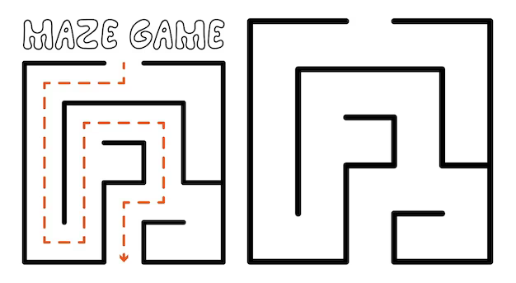

start
finish

Slide 536
maze B

Slide 537
start
finish

Slide 538
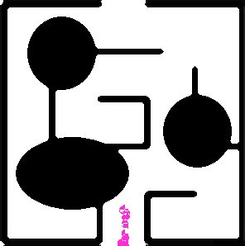

Slide 540
[worms world party]

Slide 541
trees vs. graphs

Slide 542
the problem with naively traversing a graph

Slide 543
directed cycles (loops) in the graph will create infinite loops in your code

Slide 544
[example (live coding)]
0
1
2
3

Slide 545
how to traverse a graph

Slide 546
to traverse a graph, you need to keep track of which nodes you have visited
Option A: Store a boolean called hasBeenVisited on each Node.
Option B: Use another data structure to keep track of visited nodes.
for example, HashMap<Node, Boolean> hasNodeBeenVisited;
or even better (smaller), HashSet<Node> visitedNodes;

Slide 547
example: traversing a graph with a directed cycle
1
2
3

Slide 548
example: flood fill 🪣

Slide 549
quadtree rabbit hole 🐰

Slide 550
problem: naive collision detection is slow O(n^2) to check all pairs

Slide 551
idea: use a grid O(n) to assign all circles to grid cells

Slide 552
problem: so many grid cells; most empty!

Slide 553
idea: "only have grid where you need it"

Slide 554
problem: how do we store this?

Slide 555
idea: a tree

Slide 556
idea: a tree

Slide 557
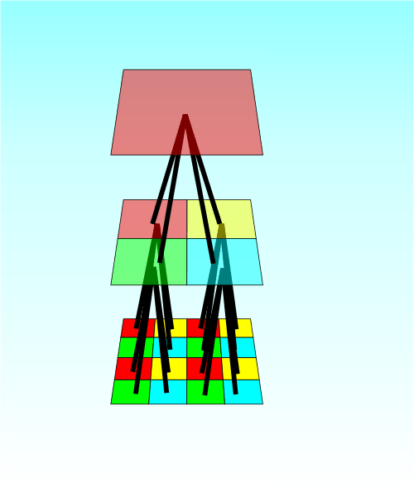

Slide 558
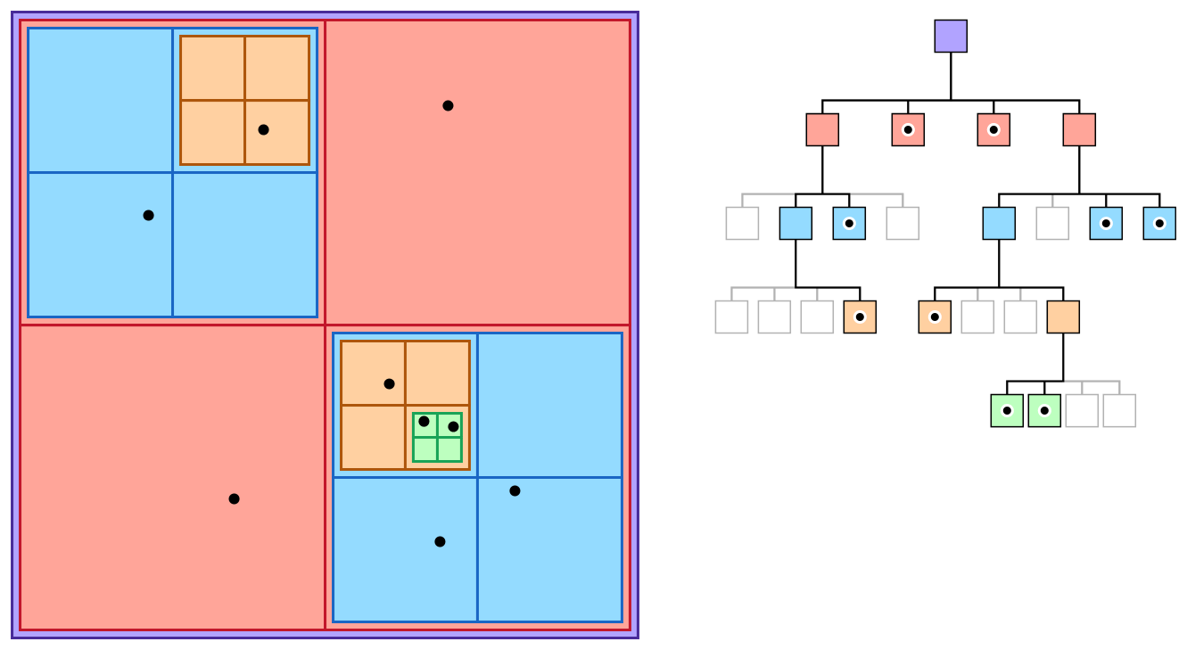

Slide 559
quadtree reading

Slide 560
Week08a
ANNOUNCEMENTS today is No Laptop Monday!
WARMUP "a chain is only as strong as its weakest link"
- what does this expression mean?
- what is a chain?
- what is a link?
- is this true for real-world metal chains? why or why not?
TODAY linked lists
🦜🦜🦜🦜🦜🦜🦜🦜

Slide 561


Slide 562
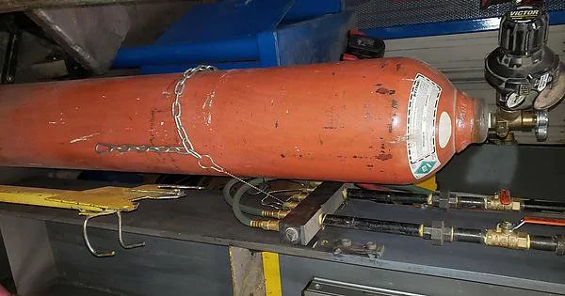

Slide 563
linked lists
record lecture

Slide 564
(p)review: list interface

Slide 565
list interface
// Get the element with this index.
ElementType get(int index);
// Add (append) an element to the back of the list. void add();
// Add (insert) an element into the list so it has this index void add(int index, ElementType element);
// Remove (delete) the element in the list at this index. void remove(int index);
// Get the number of elements currently in the list. int size();

Slide 566
list interface (cont.)
// NOTE: Many other functions could be included // in this interface.
void sort(); // Sort the list.
void reverse(); // Reverse the list.
List<ElementType> sorted(); // Get sorted copy of the list.
List<ElementType> reversed(); // Get reversed copy of list.
// Get index of first element with this value. int find(ElementType element);
...

Slide 567
a few weeks ago, we implemented the list interface using an array the array list

Slide 568
this week, we will implement the list interface using nodes with "links" (references) to other nodes this will be called a linked list

Slide 569
note

Slide 570
today we will be discussing the simplest possible linked list (LinkedList literally just has a reference to Node head.)

Slide 571
🐍
3.0
head
|
|
head.next
|
|
|
|
|
null

Slide 572
some other implementations are possible. some will be faster than this one.

Slide 573
for linked lists, do NOT memorize big O runtimes out of context

Slide 574
why are we doing this?

Slide 575
A: it will be cool to see two very different implementations of the same interface ☃️

Slide 576
B: linked lists will prepare us for trees and graphs🌳

Slide 577
C: linked lists are incredibly FUNdaMENTAL 🥳 (for us, as fundamental as arrays)

Slide 578
D: linked lists are actually big O better (than array lists) in very specific cases

Slide 579
E: linked lists are actually really, really important (especially in the C programming language)

Slide 580
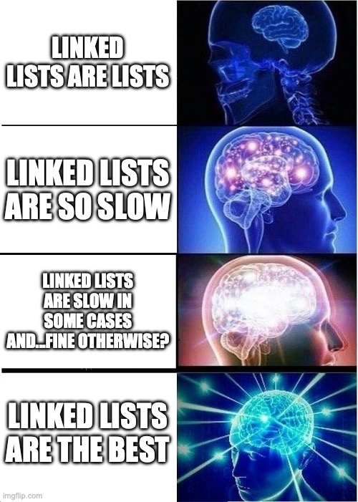

Slide 581
linked list

Slide 583
1.0
2.0
3.0

Slide 584
3.0
1.0
2.0

Slide 585
linked list
LinkedList list = new LinkedList();
class LinkedList {
Node head;
}
list.head = new Node(1.0);
1.0
class Node {
Value value;
Node next;
Node(Value value) {
this.value = value;
}
}
list.head.next = new Node(2.0);
1.0
2.0
list.head.next.next = new Node(3.0);
1.0
2.0
3.0

Slide 586
linked list
LinkedList list = new LinkedList();
class LinkedList {
Node head;
void add(Value value) {
...
}
}
list.add(1.0);
1.0
list.add(2.0);
1.0
2.0
class Node {
Value value;
Node next;
Node(Value value) {
this.value = value;
}
}
list.add(3.0);
1.0
2.0
3.0

Slide 587
example: addFront(value)

Slide 588
addFront(2.0)
value
next
value
next
3.0
4.0 | null
head

Slide 589
addFront(2.0)
3.0
4.0 | null
head

Slide 590
addFront(2.0)
Node tmp = new Node(2.0);
2.0 | null
3.0
4.0 | null
tmp
head

Slide 591
addFront(2.0)
2.0 | null
3.0
4.0 | null
tmp
head

Slide 592
addFront(2.0)
tmp.next = head;
2.0
3.0
4.0 | null
tmp
head

Slide 593
addFront(2.0)
2.0
3.0
4.0 | null
tmp
head

Slide 594
addFront(2.0)
head
head = tmp;
2.0
3.0
4.0 | null
tmp

Slide 595
addFront(2.0)
head
2.0
3.0
4.0 | null
tmp

Slide 596
addFront(2.0)
head
2.0
3.0
4.0 | null
// tmp leaves scope
tmp

Slide 597
addFront(2.0)
head
2.0
3.0
4.0 | null

Slide 598
same thing but with labels instead of arrows for head and tmp

Slide 599
addFront(2.0)
head
3.0
4.0 | null

Slide 600
addFront(2.0)
Node tmp = new Node(2.0);
tmp
head
2.0 | null
3.0
4.0 | null

Slide 601
addFront(2.0)
tmp
head
2.0 | null
3.0
4.0 | null

Slide 602
addFront(2.0)
tmp.next = head;
tmp
head
2.0
3.0
4.0 | null

Slide 603
addFront(2.0)
tmp
head
2.0
3.0
4.0 | null

Slide 604
addFront(2.0)
head = tmp;
head
2.0
3.0
4.0 | null

Slide 605
addFront(2.0)
head
2.0
3.0
4.0 | null

Slide 606
head
2.0
3.0
4.0 | null

Slide 607
2.0
3.0
4.0
(even) more abstract diagram

Slide 608
example: remove

Slide 609
remove
prev
curr
curr.next
3.0
4.0
5.0
Node prev = null; // the previous node
Node curr = head; // the current node
while (...) {
...
prev = curr;
curr = curr.next;
}

Slide 610
remove
prev
curr
curr.next
3.0
4.0
5.0

Slide 611
remove
prev
curr
curr.next
3.0
4.0
5.0

Slide 612
remove
prev.next = curr.next;
prev
curr
curr.next
3.0
4.0
5.0

Slide 613
remove
prev.next = curr.next;
prev
curr
curr.next
3.0
4.0
5.0

Slide 614
remove
prev.next = curr.next;
prev
curr.next
3.0
5.0

Slide 615
remove
3.0
5.0

Slide 616
remove
3.0
5.0

Slide 617
where did the middle node go? - way back when...we created it using new - then we just like..."stopped referring to it" - is it gone now? 😥

Slide 618
🚛it has been garbage collected

Slide 619
[board discussion of "no directed path from stack to the node"]

Slide 620
big O runtimes

Slide 621
what is the big O runtime of size()? [pointing activity]

Slide 622
O(n) 😢

Slide 623
singly-linked list worst case runtimes
head
list.add(index, value)
// O(n)
list.removeByIndex(index)
// O(n)
list.size()
// O(n)
list.addFront() // list.add(0, value)
// O(1)
list.removeFront() // list.removeByIndex(0)
// O(1)
list.addBack()
// O(n)
list.removeBack()
// O(n)

Slide 624
beyond big O runtime

Slide 625

what does this actually look like in memory?
1.0
2.0
3.0

Slide 626
class LinkedList {
Node head;
}
list
LinkedList list = new LinkedList();
list.head = new Node(1.0);
list.head.next = new Node(2.0);
list.head.next.next = new Node(3.0);
0x0a2bcefa
class Node {
double value;
Node next;
}
0x2349d47a3
1.0 0x05287a12
3.0 null
2.0 0xab334b19

Slide 627
1.0 0x05287a12
3.0 null
2.0 0xab334b19

Slide 628
what does this mean? cons? ☹️ pros? 🙂 (how is this very different than an array list?)

Slide 629
https://x.com/_kzr/status/1672497446705037312

Slide 630
class LinkedList {
Node head;
}
List list = new List();
list.head = new Node("Hans");
list.head.next = new Node("The");
list.head.next.next = new Node("Parrot");
list
class Node {
String value;
Node next;
}
0x0a2bcefa
'H' 'a' 'n' 's'
0x2349d47a3
'T' 'h' 'e'
0x234c8b7a 0x05287a12
0x7766231a null
0x3425ff1a 0xab334b19
'P' 'a' 'r' 'r' 'o' 't'

Slide 632
ANNOUNCEMENTS friday's colloquium will be cool!
my friend Pascal makes ✨underwater robotic spheres✨!
midterms will be returned Fri
WARMUP review: for a linked list, size() is O(n) runtime
- how could you make size() (or perhaps... size) O(1)?
-- is this at all...spooky?👻
TODAY size() and riffs on linked lists
Week08b
🦜🦜🦜🦜🦜🦜🦜🦜

Slide 633
🐍
3.0
the front of the snek
head
|
|
head.next
|
|
|
|
the back of the snek
|
null

Slide 634
linked lisssssst

Slide 635
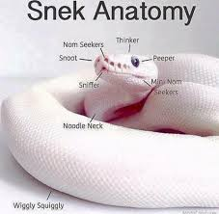

Slide 636
[record lecture]

Slide 637
LinkedList review

Slide 638
runtimes

Slide 639
worst case singly-linked list runtimes
head
list.add(index, value)
// O(n)
list.removeByIndex(index)
// O(n)
list.size()
// O(n)
list.addFront()
// O(1)
list.removeFront()
// O(1)
list.addBack()
// O(n)
list.removeBack()
// O(n)

Slide 640
additional warmup: prepending a list

Slide 641
example
Node snap = new Node(1.0);
Node crackle = new Node(2.0);
Node pop = new Node(3.0);
snap.next = crackle;
crackle.next = pop;
pop.next = head;
head = snap;
✍️
4.0
5.0
head

Slide 642
example
Node snap = new Node(1.0);
Node crackle = new Node(2.0);
Node pop = new Node(3.0);
snap.next = crackle;
crackle.next = pop;
pop.next = head;
head = snap;
4.0
5.0
head

Slide 643
example
Node snap = new Node(1.0);
Node crackle = new Node(2.0);
Node pop = new Node(3.0);
snap.next = crackle;
crackle.next = pop;
pop.next = head;
head = snap;
snap
1.0 | null
4.0
5.0
head

Slide 644
example
Node snap = new Node(1.0);
Node crackle = new Node(2.0);
Node pop = new Node(3.0);
snap.next = crackle;
crackle.next = pop;
pop.next = head;
head = snap;
snap
crackle
1.0 | null
2.0 | null
4.0
5.0
head

Slide 645
example
Node snap = new Node(1.0);
Node crackle = new Node(2.0);
Node pop = new Node(3.0);
snap.next = crackle;
crackle.next = pop;
pop.next = head;
head = snap;
snap
crackle
pop
1.0 | null
2.0 | null
3.0 | null
4.0
5.0
head

Slide 646
example
Node snap = new Node(1.0);
Node crackle = new Node(2.0);
Node pop = new Node(3.0);
snap.next = crackle;
crackle.next = pop;
pop.next = head;
head = snap;
snap
crackle
pop
1.0
2.0 | null
3.0 | null
4.0
5.0
head

Slide 647
example
Node snap = new Node(1.0);
Node crackle = new Node(2.0);
Node pop = new Node(3.0);
snap.next = crackle;
crackle.next = pop;
pop.next = head;
head = snap;
snap
crackle
pop
1.0
2.0
3.0 | null
4.0
5.0
head

Slide 648
example
Node snap = new Node(1.0);
Node crackle = new Node(2.0);
Node pop = new Node(3.0);
snap.next = crackle;
crackle.next = pop;
pop.next = head;
head = snap;
snap
crackle
pop
1.0
2.0
3.0
4.0
5.0
head

Slide 649
example
Node snap = new Node(1.0);
Node crackle = new Node(2.0);
Node pop = new Node(3.0);
snap.next = crackle;
crackle.next = pop;
pop.next = head;
head = snap;
snap
crackle
pop
1.0
2.0
3.0
4.0
5.0
head

Slide 650
example
Node snap = new Node(1.0);
Node crackle = new Node(2.0);
Node pop = new Node(3.0);
snap.next = crackle;
crackle.next = pop;
pop.next = head;
head = snap;
1.0
2.0
3.0
4.0
5.0
head

Slide 651
🧠 was that faster than calling addFront() n times? 🧠 same big O or different big O? (if we were to call it many times)
Node snap = new Node(1.0);
Node crackle = new Node(2.0);
Node pop = new Node(3.0);
snap.next = crackle;
crackle.next = pop;
pop.next = head;
head = snap;
addFront(3.0);
addFront(2.0);
addFront(1.0);
vs.

Slide 652
🧠 was that faster than calling addFront() n times? yes (only updated head once) 🧠 same big O or different big O? same (still have to "hook up" O(n) references)

Slide 653
[implement LinkedList]

Slide 654
[implement LinkedList]

Slide 655
size()

Slide 656
[ implement size() poorly ]

Slide 657
[ implement size() poorly ]

Slide 658
joyful implementation of size

Slide 659
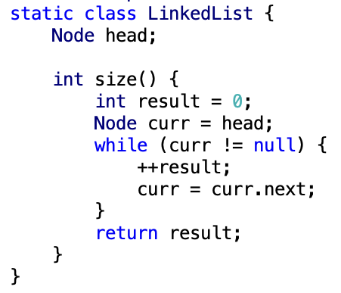

Slide 660
size()
what is the big O runtime of this method?
O(n) ☹️
this seems like a pretty steep cost to pay just to know the list’s size... what would be a more efficient approach?
store size as an instance variable
update it every time you change the number of elements in the list (inside of add, remove, etc.)
what is the runtime of this approach?
O(1) 🙂

Slide 661
while way more efficient, this approach is perhaps a bit spooky 👻 multiple functions are now also responsible for carefully modifying an instance variable (mess up, and any code that depends on size will be very weirdly broken)

Slide 662
note: the A homework doesn't use size at all

Slide 663
but if you were going to implement/use the list's size... i would start with size() as a function, get everything working perfectly, and only then carefully turn it into an instance variable 🙂👍

Slide 664

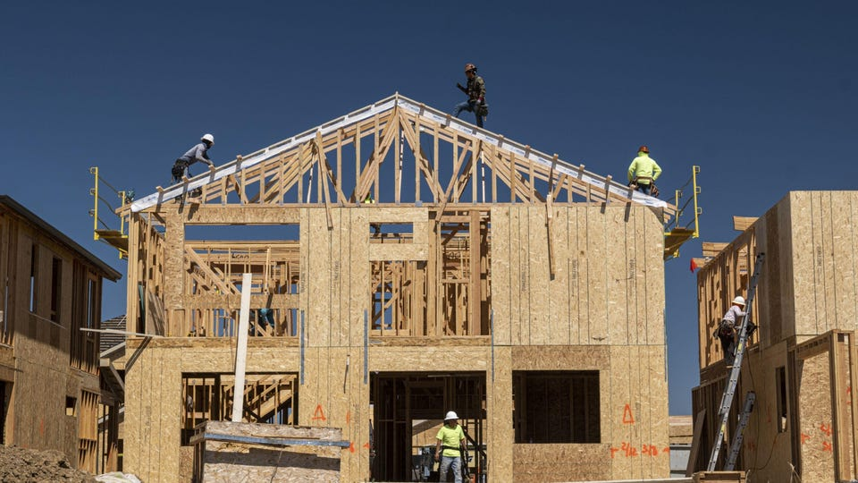
(it's this thing again)

Slide 665
tail reference

Slide 666
singly-linked list with reference to tail
head
tail
class LinkedList {
Node head;
Node tail;
}
class Node {
Value value;
Node next;
}

Slide 667
singly-linked list with reference to tail worst case runtimes
head
tail
list.add(index, value)
// O(n)
list.removeByIndex(index)
// O(n)
list.size()
// O(n)
list.addFront()
// O(1)
list.removeFront()
// O(1)
list.addBack()
// O(1) 😀
list.removeBack()
// O(n) 😡

Slide 668
doubly-linked list

Slide 669
singly- vs. doubly-linked

Slide 670
singly-linked list
head
class LinkedList {
Node head;
}
class Node {
Value value;
Node next;
}

Slide 671
doubly-linked list
tail
head
class LinkedList2 {
Node2 head;
Node2 tail;
}
class Node2 {
Value value;
Node2 next;
Node2 prev;
}

Slide 672
🤷
3.0
4.0
5.0

Slide 673
3.0
4.0
5.0

Slide 674
runtimes

Slide 675
worst case doubly-linked list runtimes
tail
head
list.add(index, value)
// O(n)
list.removeByIndex(index)
// O(n)
list.size()
// O(n)
list.addFront()
// O(1)
list.removeFront()
// O(1)
list.addBack()
// O(1) 😀
list.removeBack()
// O(1) 😀

Slide 676
a doubly-linked list is a great way to implement a deque (double-ended queue)
O(1) addFront() O(1) removeFront() O(1) addBack() O(1) removeBack()
🧠 could you pull this off with an array list?
no.
addFront() is O(n)
🧠 could you pull this off with an array?
sort of!—the array deque (amortized O(1) add)

Slide 677
Week08c
warmup: have you pre-registered? what classes are you taking?
🦜
underwater robotic spheres!
colloquium today in Wege (TCL123)
@ 2:30pm

Slide 678
pre-reg

Slide 679
237

Slide 680
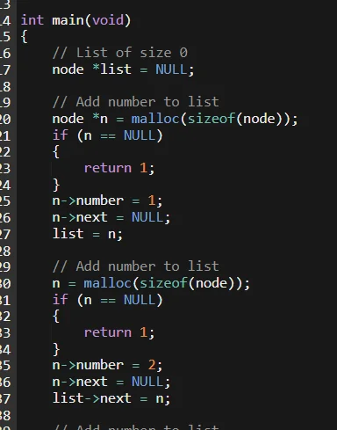

Slide 681
"the stack"
local variable primitives & references to Objects
undefined by default (will NOT compile if used)
"the heap"
the actual Objects (arrays and String's count as Objects)
cleared to 0 or null by default

Slide 683
LinkedList list =
new LinkedList("Hans -> Parrot");

Slide 684
LinkedList list;
{
Node node;
String string;
list = new LinkedList();
node = new Node();
string = "Hans";
node.value = string;
list.head = node;
node = new Node();
string = "Parrot";
node.value = string;
list.head.next = node;
}

Slide 685
LinkedList list;
{
Node node;
String string;
list = new LinkedList();
node = new Node();
string = "Hans";
node.value = string;
list.head = node;
node = new Node();
string = "Parrot";
node.value = string;
list.head.next = node;
}
list
UNDEFINED

Slide 686
LinkedList list;
{
Node node;
String string;
list = new LinkedList();
node = new Node();
string = "Hans";
node.value = string;
list.head = node;
node = new Node();
string = "Parrot";
node.value = string;
list.head.next = node;
}
list
node
UNDEFINED
UNDEFINED

Slide 687
LinkedList list;
{
Node node;
String string;
list = new LinkedList();
node = new Node();
string = "Hans";
node.value = string;
list.head = node;
node = new Node();
string = "Parrot";
node.value = string;
list.head.next = node;
}
list
node
string
UNDEFINED
UNDEFINED
UNDEFINED

Slide 688
LinkedList list;
{
Node node;
String string;
list = new LinkedList();
node = new Node();
string = "Hans";
node.value = string;
list.head = node;
node = new Node();
string = "Parrot";
node.value = string;
list.head.next = node;
}
list
node
string
0x11111111
UNDEFINED
UNDEFINED
null

Slide 689
LinkedList list;
{
Node node;
String string;
list = new LinkedList();
node = new Node();
string = "Hans";
node.value = string;
list.head = node;
node = new Node();
string = "Parrot";
node.value = string;
list.head.next = node;
}
list
node
string
0x11111111
0x22222222
UNDEFINED
null
null null

Slide 690
LinkedList list;
{
Node node;
String string;
list = new LinkedList();
node = new Node();
string = "Hans";
node.value = string;
list.head = node;
node = new Node();
string = "Parrot";
node.value = string;
list.head.next = node;
}
list
node
string
0x11111111
0x22222222
0x88888888
null
null null
H a n s

Slide 691
LinkedList list;
{
Node node;
String string;
list = new LinkedList();
node = new Node();
string = "Hans";
node.value = string;
list.head = node;
node = new Node();
string = "Parrot";
node.value = string;
list.head.next = node;
}
list
node
string
0x11111111
0x22222222
0x88888888
null
0x88888888 null
H a n s

Slide 692
LinkedList list;
{
Node node;
String string;
list = new LinkedList();
node = new Node();
string = "Hans";
node.value = string;
list.head = node;
node = new Node();
string = "Parrot";
node.value = string;
list.head.next = node;
}
list
node
string
0x11111111
0x22222222
0x88888888
0x22222222
0x88888888 null
H a n s

Slide 693
LinkedList list;
{
Node node;
String string;
list = new LinkedList();
node = new Node();
string = "Hans";
node.value = string;
list.head = node;
node = new Node();
string = "Parrot";
node.value = string;
list.head.next = node;
}
list
node
string
0x11111111
0x33333333
0x88888888
0x22222222
0x88888888 null
null null
H a n s

Slide 694
LinkedList list;
{
Node node;
String string;
list = new LinkedList();
node = new Node();
string = "Hans";
node.value = string;
list.head = node;
node = new Node();
string = "Parrot";
node.value = string;
list.head.next = node;
}
list
node
string
0x11111111
0x33333333
0x99999999
0x22222222
0x88888888 null
null null
H a n s
P a r r o t

Slide 695
LinkedList list;
{
Node node;
String string;
list = new LinkedList();
node = new Node();
string = "Hans";
node.value = string;
list.head = node;
node = new Node();
string = "Parrot";
node.value = string;
list.head.next = node;
}
list
node
string
0x11111111
0x33333333
0x99999999
0x22222222
0x88888888 null
0x99999999 null
H a n s
P a r r o t

Slide 696
LinkedList list;
{
Node node;
String string;
list = new LinkedList();
node = new Node();
string = "Hans";
node.value = string;
list.head = node;
node = new Node();
string = "Parrot";
node.value = string;
list.head.next = node;
}
list
node
string
0x11111111
0x33333333
0x99999999
0x22222222
0x88888888 0x33333333
0x99999999 null
H a n s
P a r r o t

Slide 697
LinkedList list;
{
Node node;
String string;
list = new LinkedList();
node = new Node();
string = "Hans";
node.value = string;
list.head = node;
node = new Node();
string = "Parrot";
node.value = string;
list.head.next = node;
}
list
0x11111111
0x22222222
0x88888888 0x33333333
0x99999999 null
H a n s
P a r r o t

Slide 698
LinkedList list;
{
Node node;
String string;
list = new LinkedList();
node = new Node();
string = "Hans";
node.value = string;
list.head = node;
node = new Node();
string = "Parrot";
node.value = string;
list.head.next = node;
}
list
0x11111111
0x22222222
0x88888888 0x33333333
0x99999999 null
H a n s
P a r r o t

Slide 699
memory in C

Slide 700
in C, we often get to choose whether to allocate memory on the stack or the heap

Slide 701
memory allocation
// Java
int[] heapAllocatedArray = new int[10]
heapAllocatedArray[0] = 3;
// C
int stackAllocatedArray[10];
int *heapAllocatedArray = malloc(10000000 * sizeof(int));
stackAllocatedArray[0] = 3;
heapAllocatedArray[0] = 3;
free(heapAllocatedArray);

Slide 702
256

Slide 703
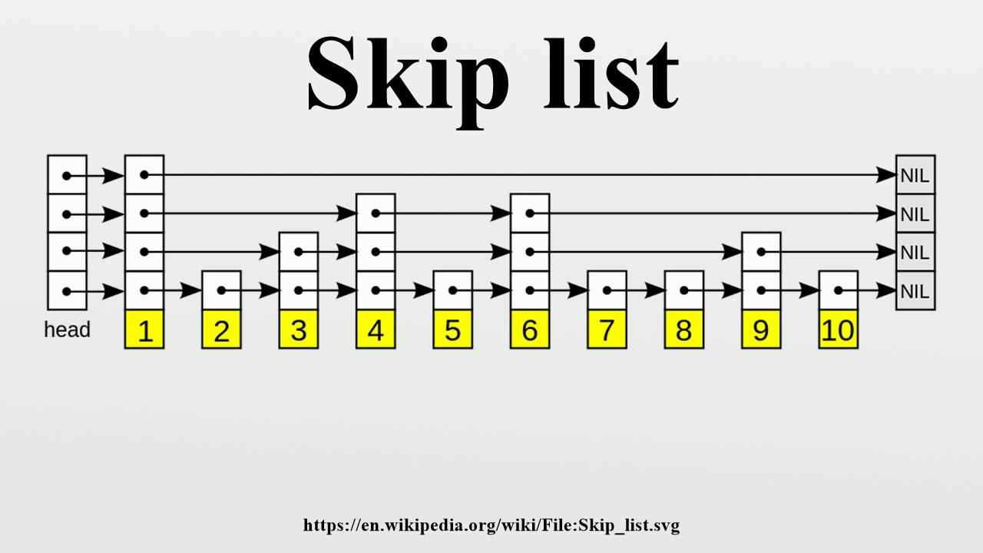

Slide 704
334

Slide 705
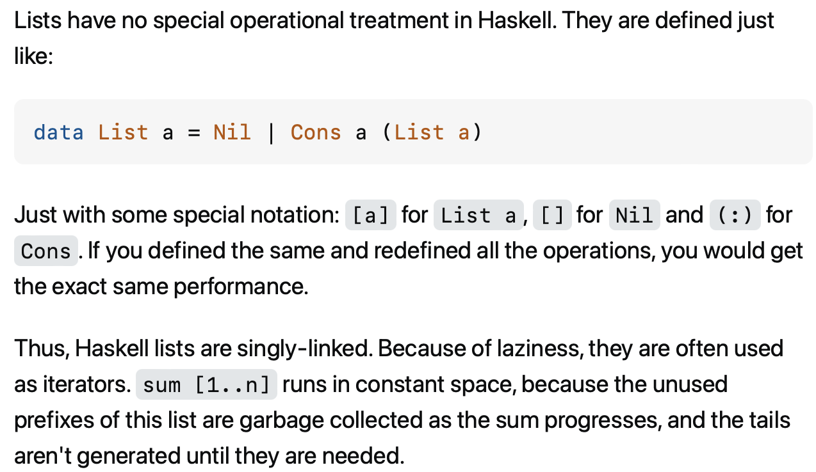

Slide 706
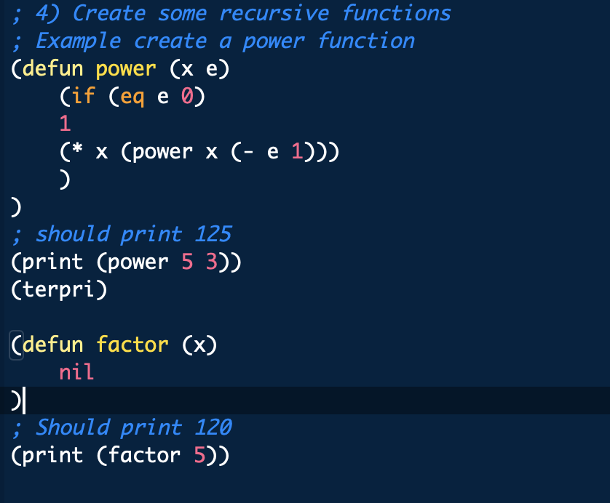

Slide 707
something fun?

Slide 708
fun friday menu - jim rants about comments and syntax highlighting - jim continues codeing (some of) microsoft paint from scratch - jim updates you on his CAD software - jim show and tells about his favorite element - jim reads aloud from grugbrain.dev - jim reads aloud from vim creep - jim reads aloud from hexing the technical interview - jim reads aloud from the truth about lisp - jim reads aloud from the worst API ever made

Slide 709
midterm

Slide 710
common areas of struggle

Slide 711
question 1
syntax
list.add(int 3); // void add(int element);
True
}

Slide 712
}
generally speaking {
you want your curly braces {
}
to look {
something like this {
}
}
}

Slide 713
}
generally speaking
{
you want your curly braces
{
}
to look
{
something like this
{
}
}
}

Slide 714
}
this is quite spooky {
and hard {
to read }
it's hard to tell {
where one scope starts {
and the next ends
}}
do i have enough braces?

Slide 715
question 3
control flow
returning too early (inside for loop)
handling special case too late (after creating array)
if...if vs. if...else if vs. if...else
syntax
list[i]
null
boolean 7Found;
;

Slide 716
question 5
complete understanding of app
pool
single enemy vs. multiple enemies

Slide 717
question 6
complete understanding of app
buffer is 8 characters long, but only length many characters are drawn
last question

Slide 718
results

Slide 719
summay
distribution is very wide (this is normal)
some grades are low (< ~50)
this does not mean you will fail the coure
"if you do all the homework, and the exams just aren't working for you, you will pass CS136" – James Bern, Fri Nov 1
my comments are very sparse
if you don't know why you lost points, or you think i may have made a mistake please ask

Slide 720
mean: 86.4
standard deviation: 15.9

Slide 721
thoughts

